Slide 1
Snowflake
Best practices

Slide 2
Best practices for Schema Design
Most of the time, tables contain a field for timestamp or date data type for required granularity. Snowflake provides an efficient result on timestamp and date type rather than VARCHAR type.
Using the clusSnowflaketering key is a good practice. If your table contains a small amount of data and aggregate data is required all the time, then these clustering may result in the generation of many small cluster files.
Always remember the column data length in case of the Snowflake as its storage may generate erroneous data when outputted.
Snowflake stores data of timestamp and date types in string formats when data type used in VARIANT, so in this case, it is recommended to flatten the structure and use appropriate type. Retrieving a string is slower than retrieving a timestamp.

Slide 3
Best practices for Query Optimization
Clustering helps to store data in the form of cluster storage files with named partitions. Tables having effective and active clusters may have bounded queries to these clusters, such as using where conditions on these clusters.
Using warehouse suspension and auto-resume also affect the query. By default, the warehouse suspension time is 10 minutes. The segmented workload must be handled by a typical virtual warehouse and by multiple users (if required). This will help to re-use the result cache generated by Snowflake and hence provides instant results on the same data.
If concurrent data is needed, Snowflake can auto-scale the warehouse, and it can be updated from the user interface. OneSnowflake should use this feature as well as an optimized query together to obtain optimization

Slide 4
Best practices for Efficient Reads
Snowflake reader is quite slow and expensive if we are accessing data with aggregations directly from Snowflake, so use “query” instead of “dbtable” in Spark-Snowflake connector, if data has some limits and conditions but no aggregation.

Slide 5
Best practices for Efficient Writes
If you are writing data to snowflake table in Spark, and that table already exists, try to select data in the same sequence/order of columns as they are in Snowflake. The workaround to resolve this is to use the “column_mapping” option as “name” while writing. “column_mapping” -> “name” approach is CASE SENSITIVE.Snowflake

Slide 6
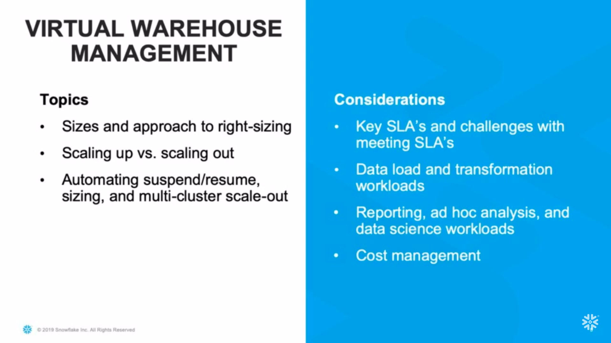

Slide 7
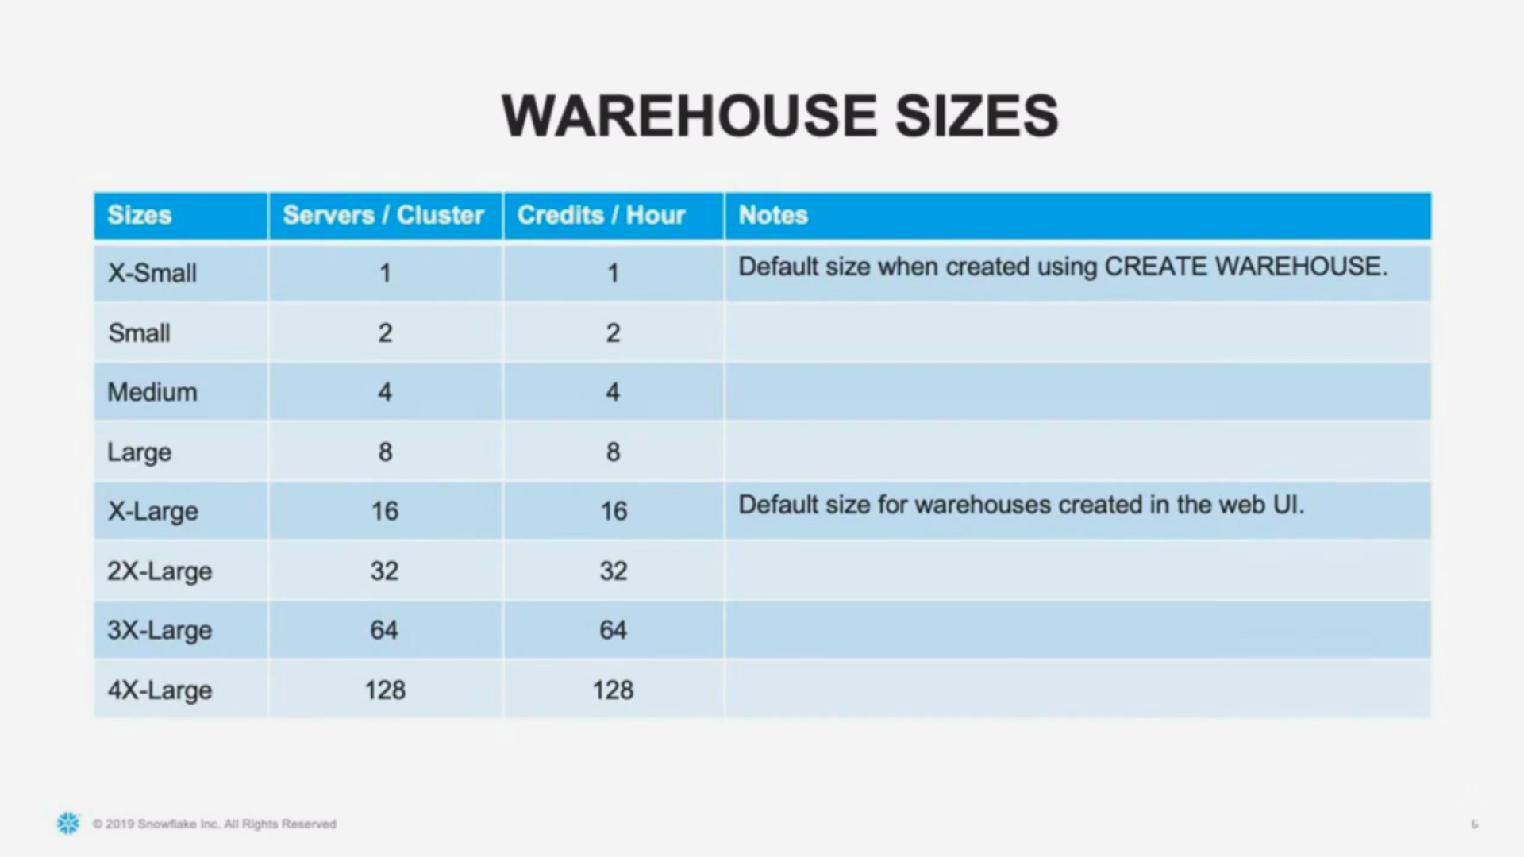

Slide 8
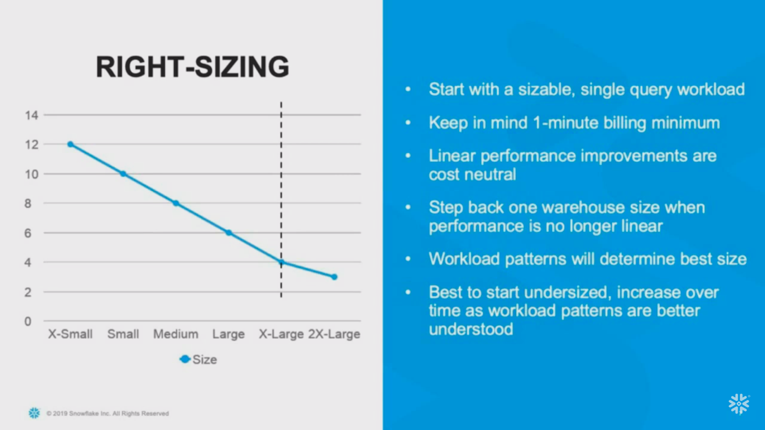

Slide 9
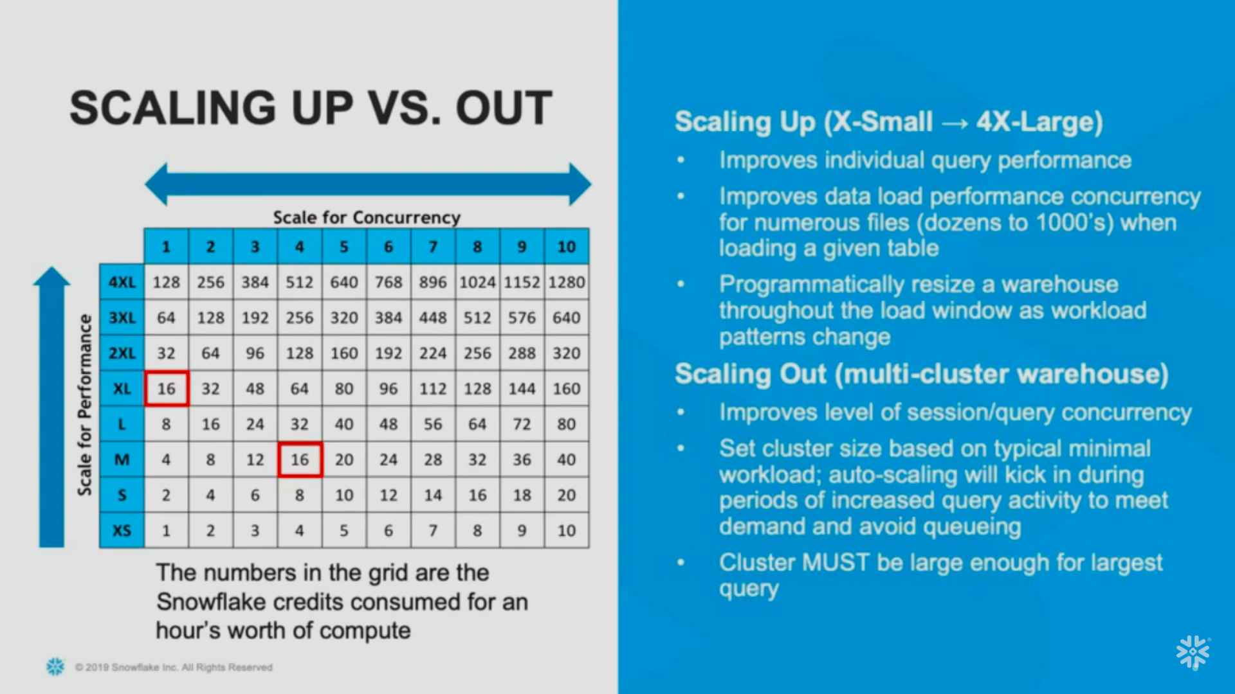

Slide 10
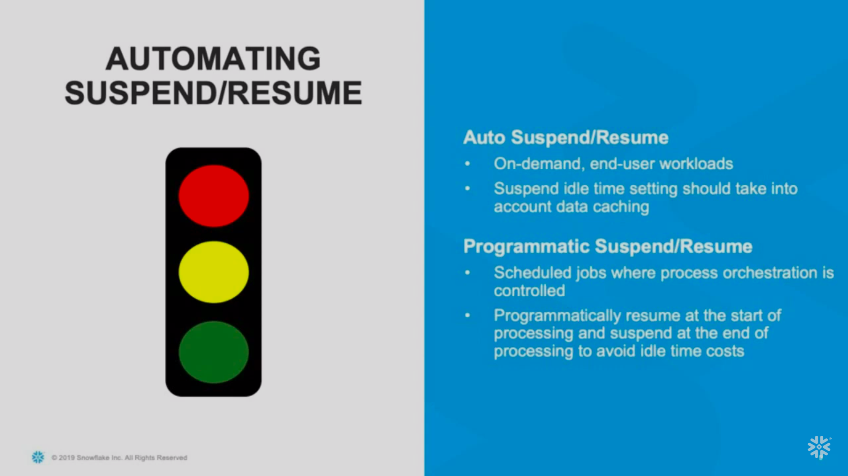

Slide 11
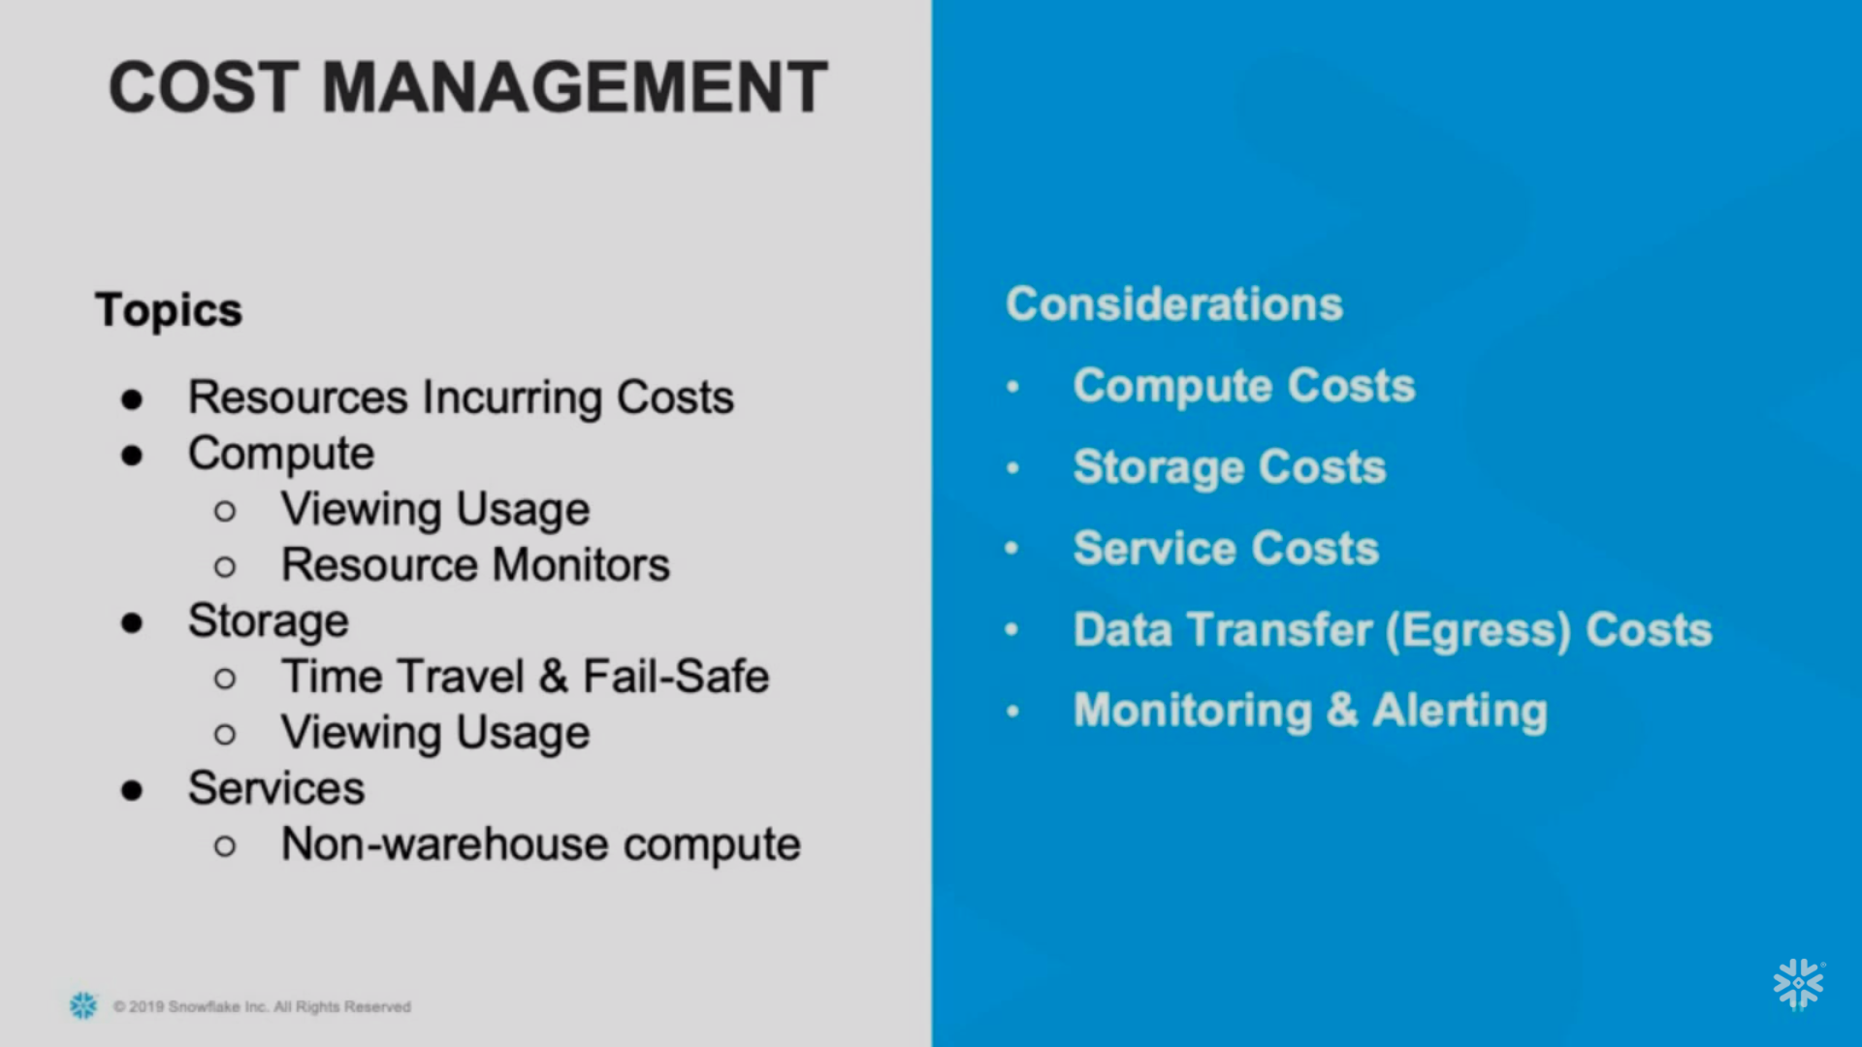

Slide 12
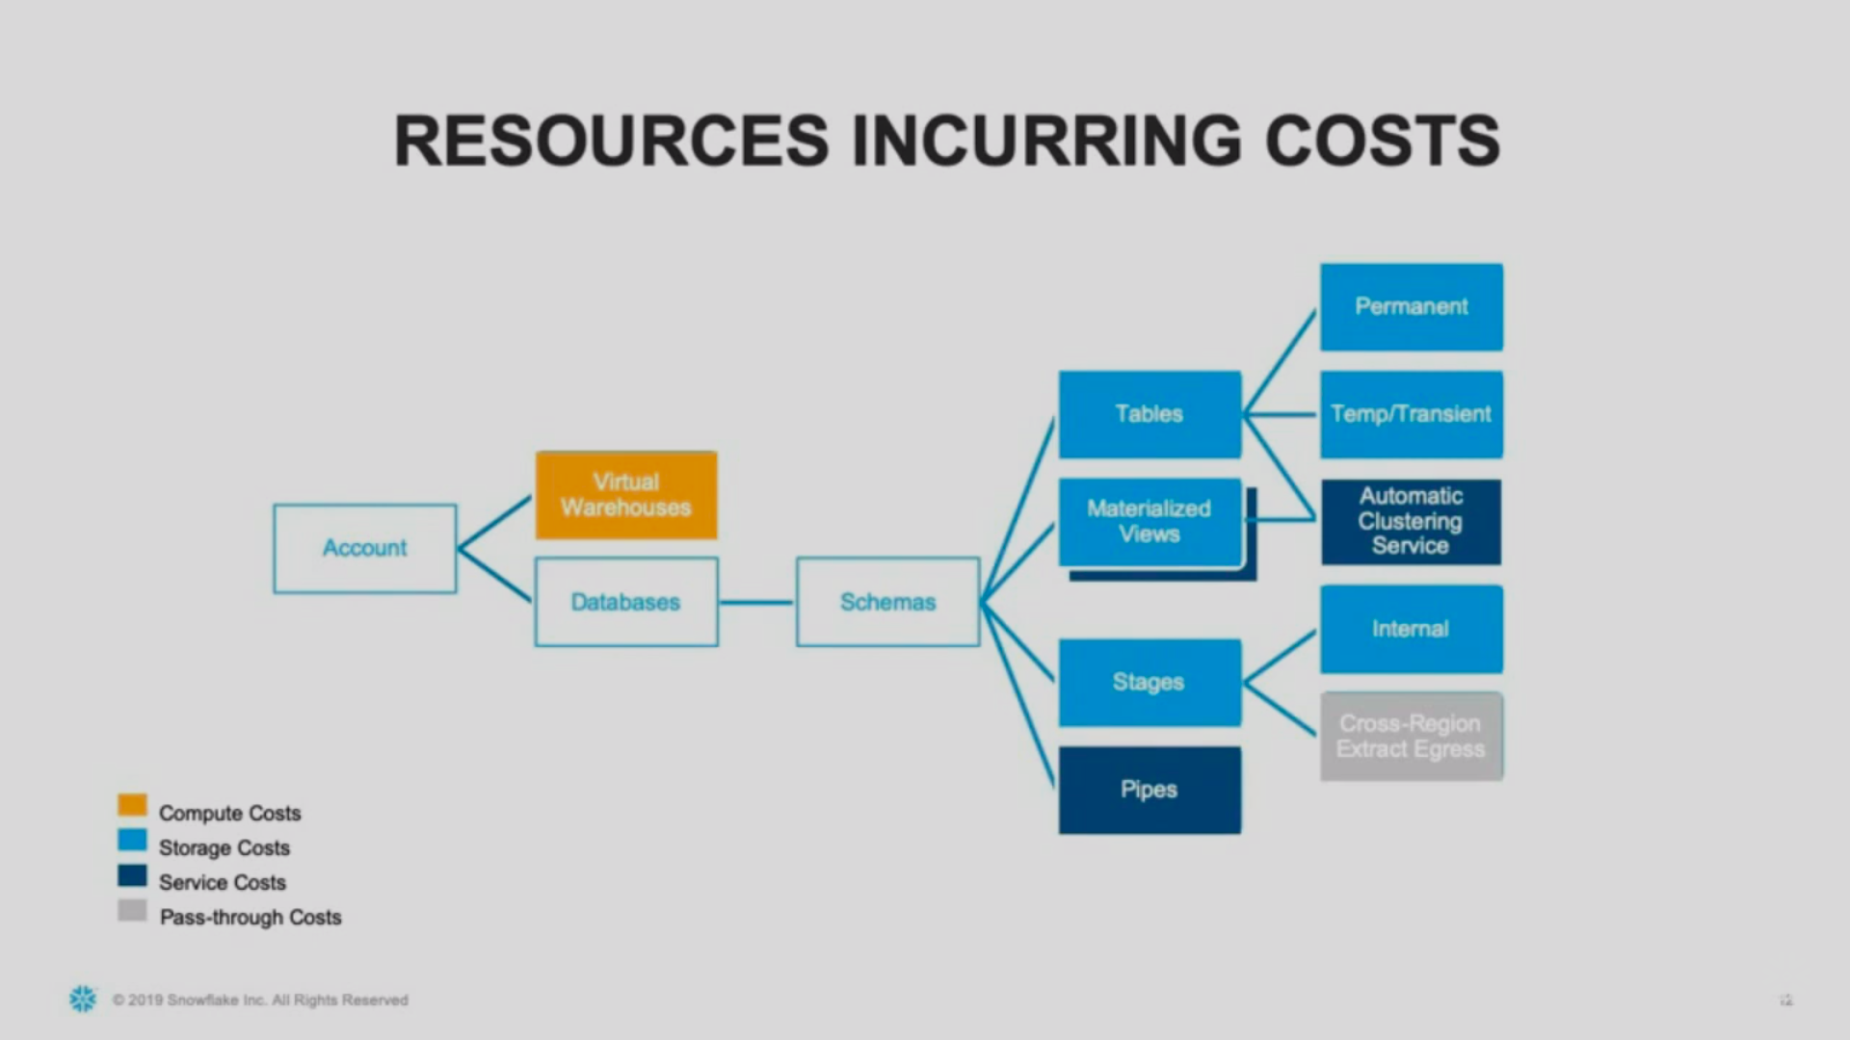

Slide 13
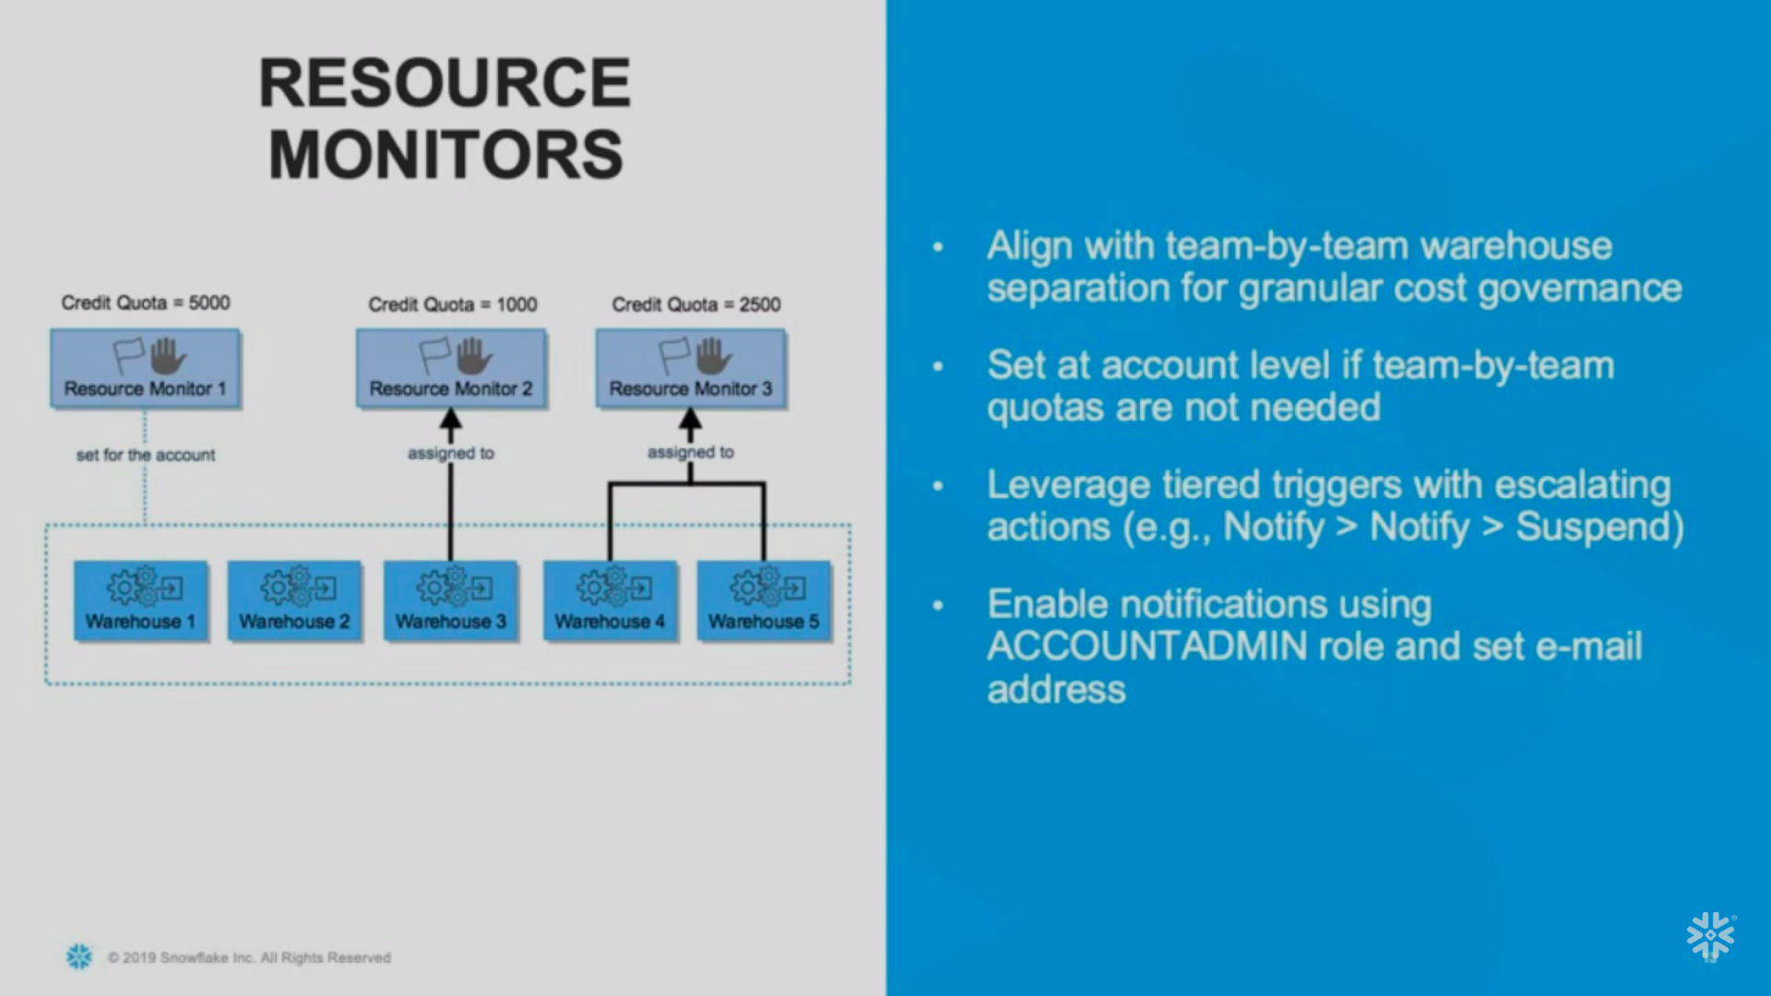

Slide 14
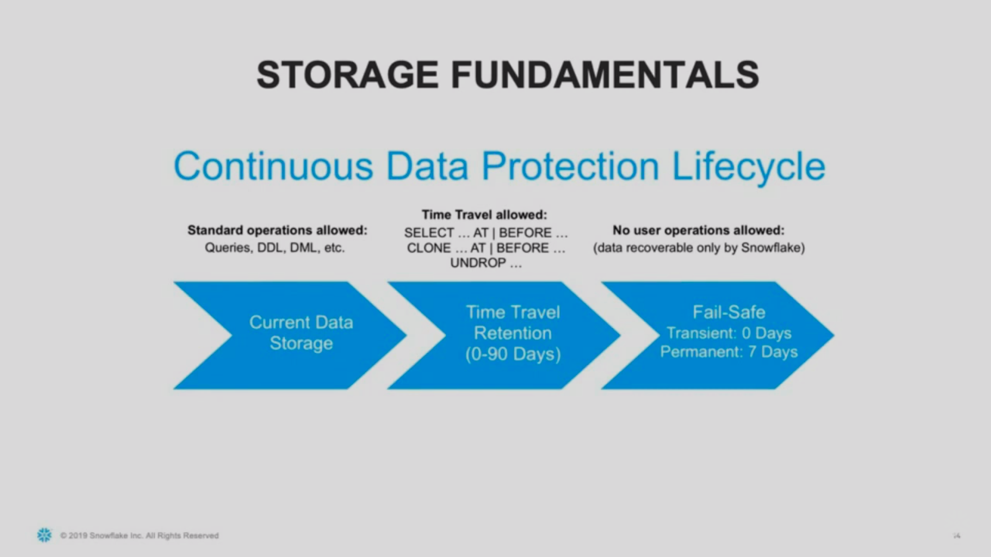

Slide 15
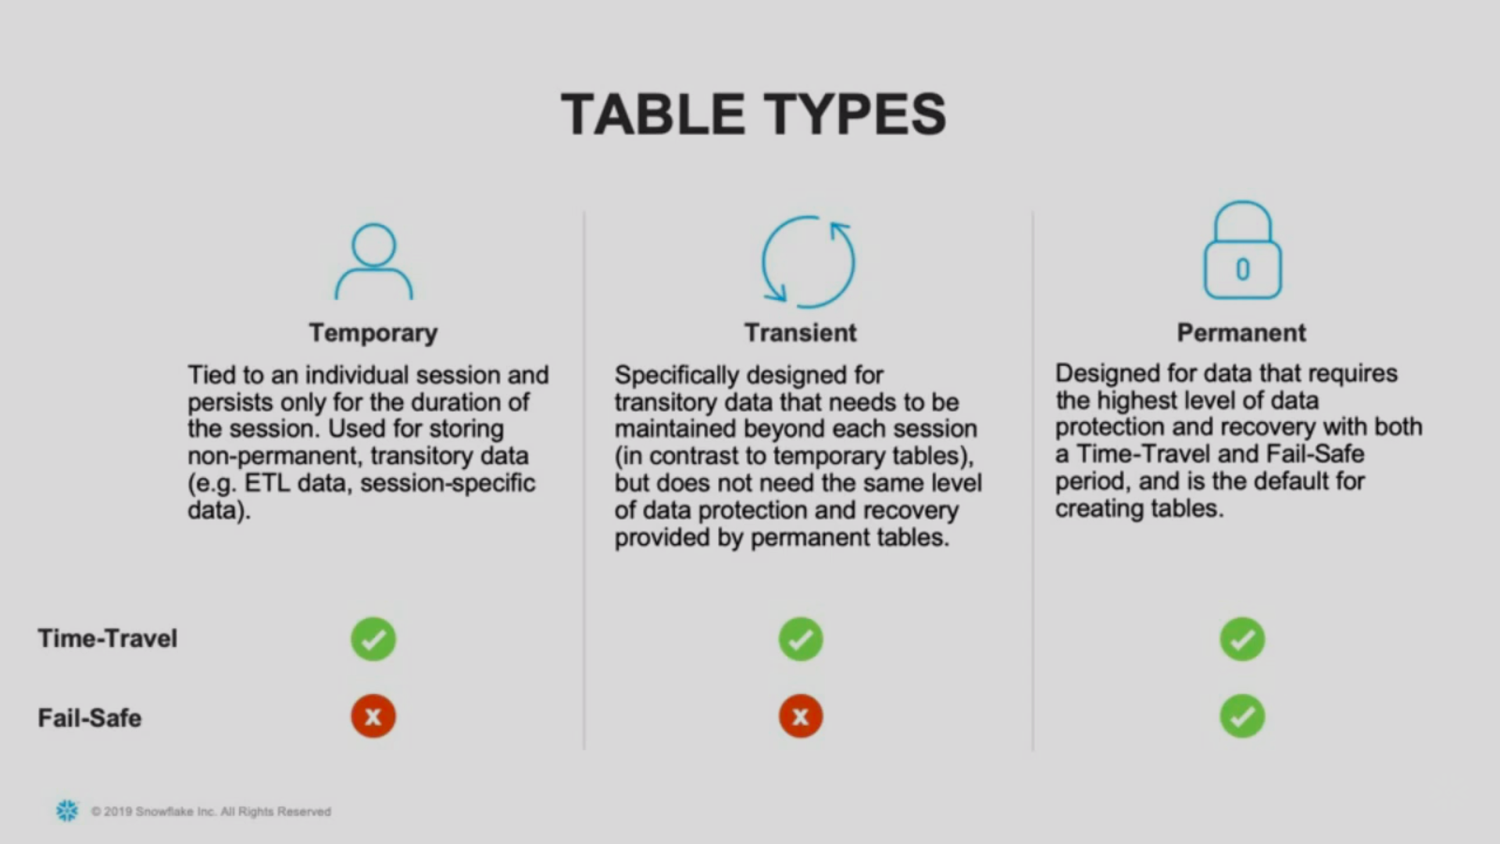

Slide 16
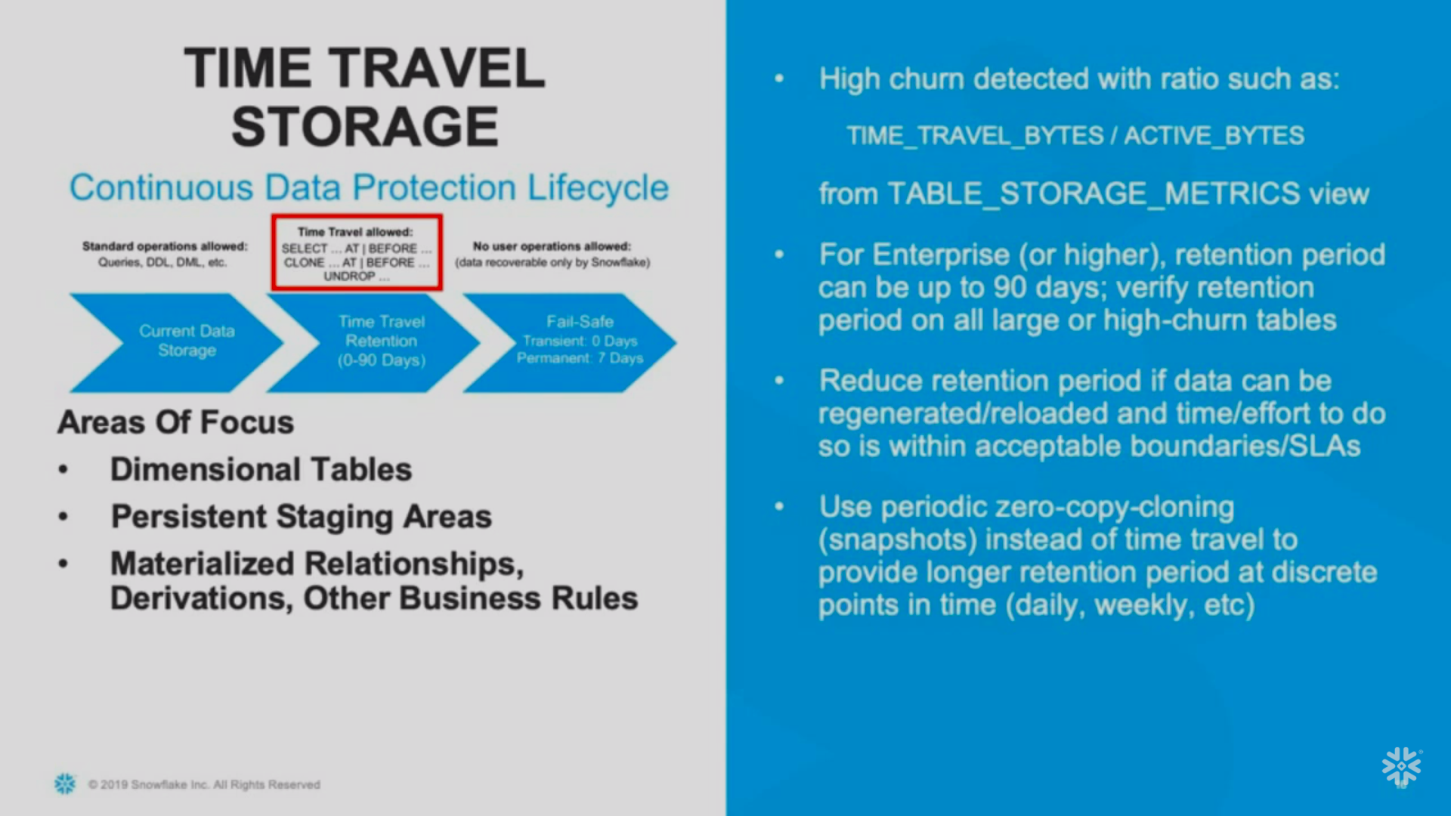

Slide 17
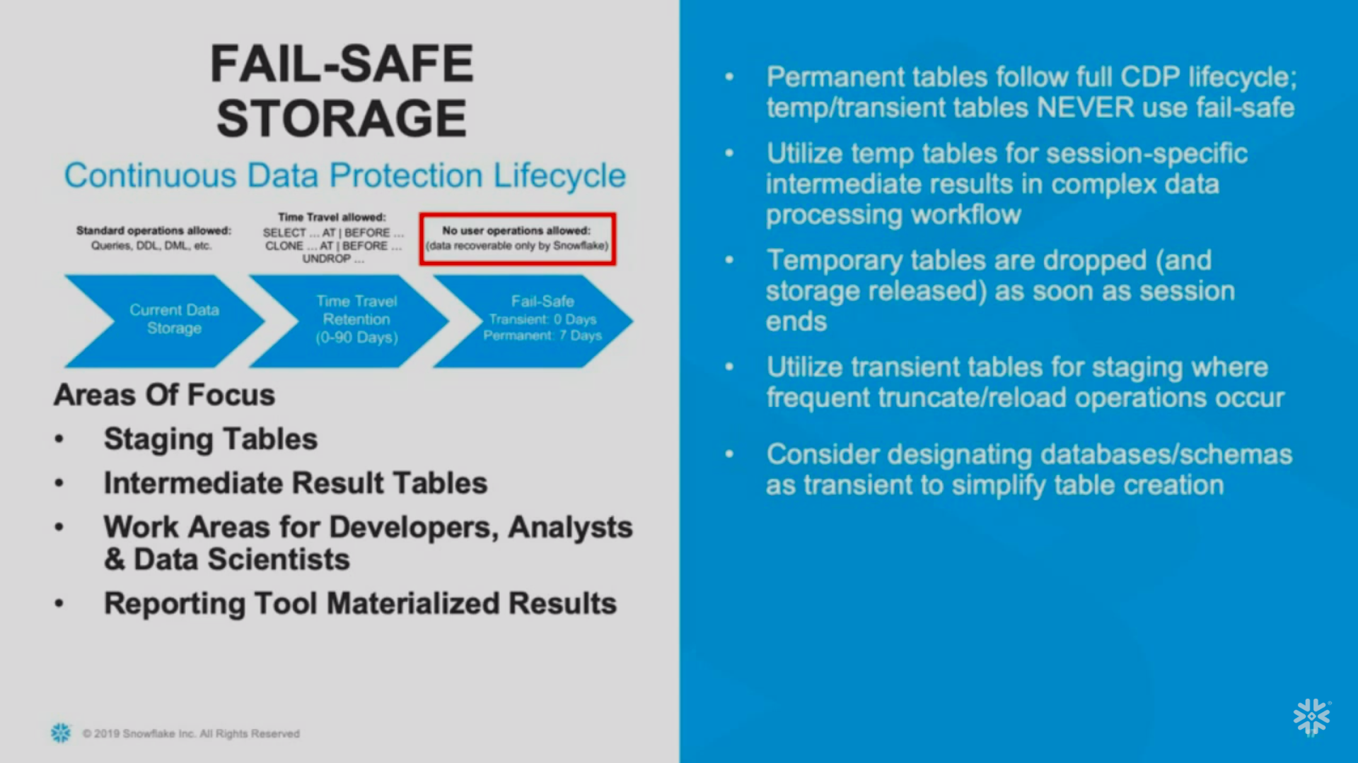

Slide 18
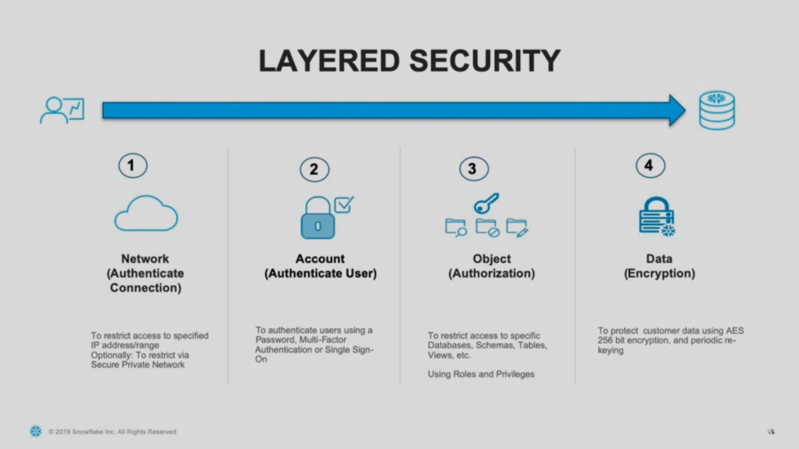

Slide 19


Slide 20
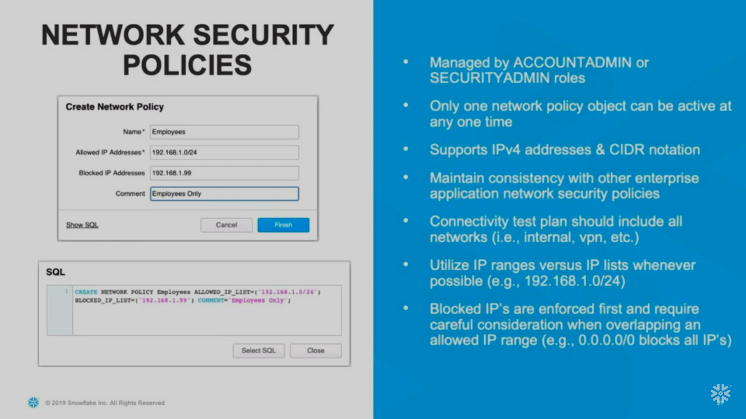

Slide 21


Slide 22
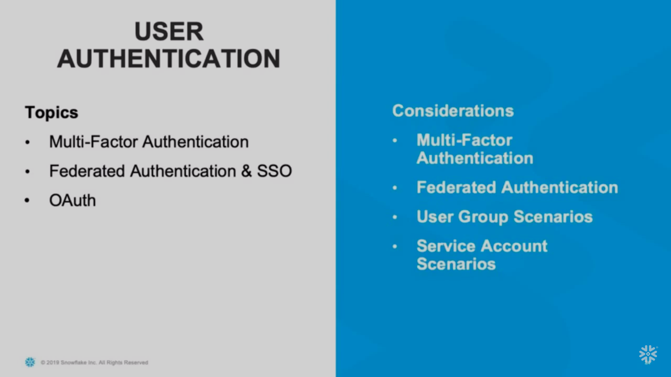

Slide 23
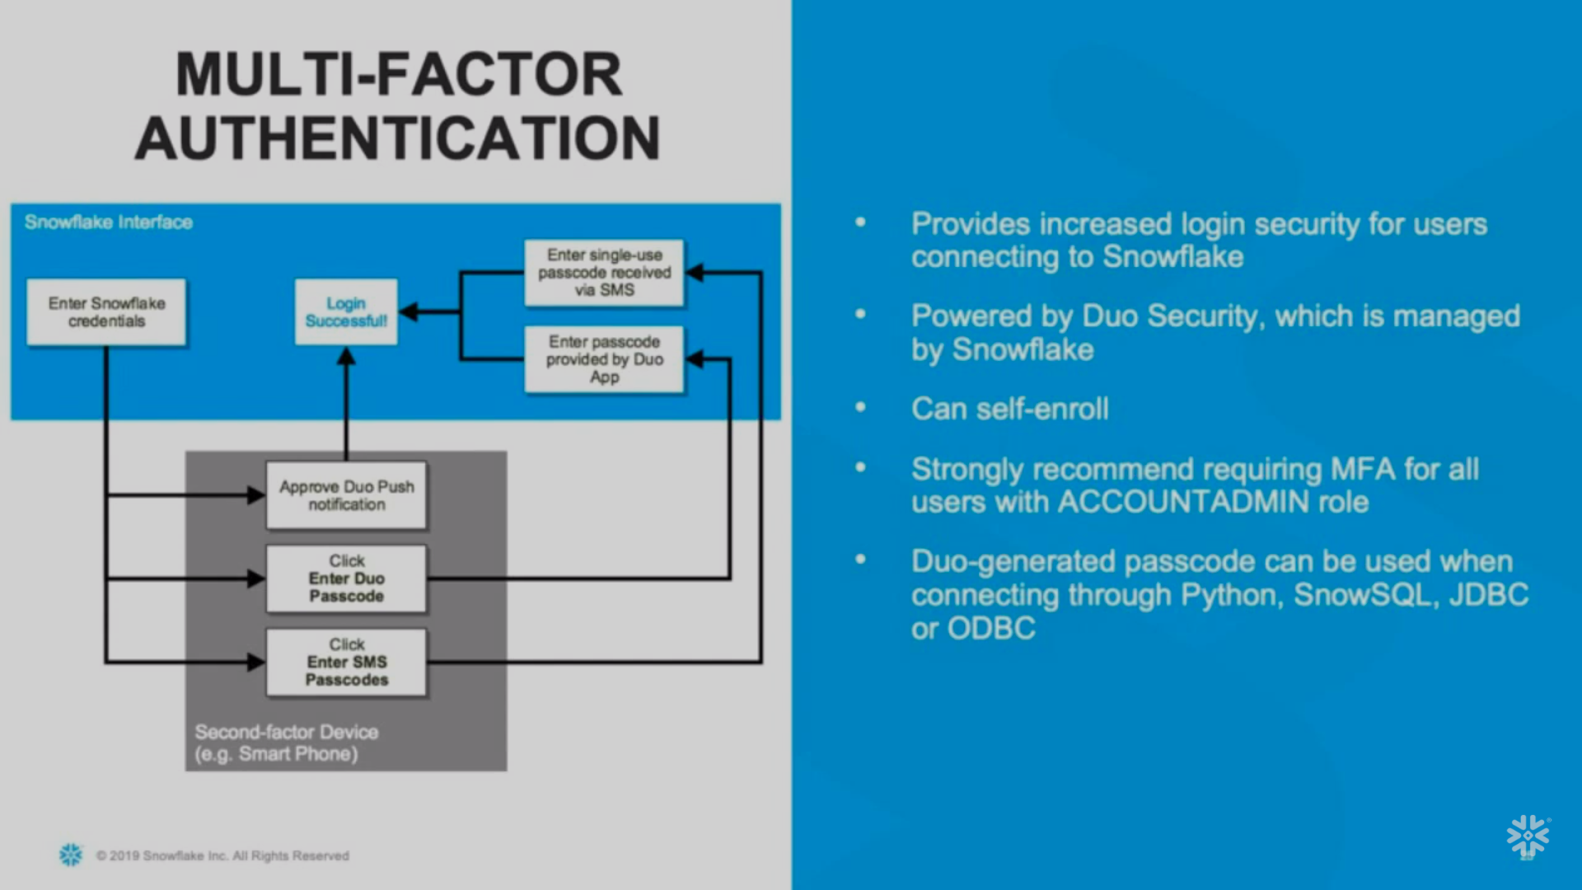

Slide 24
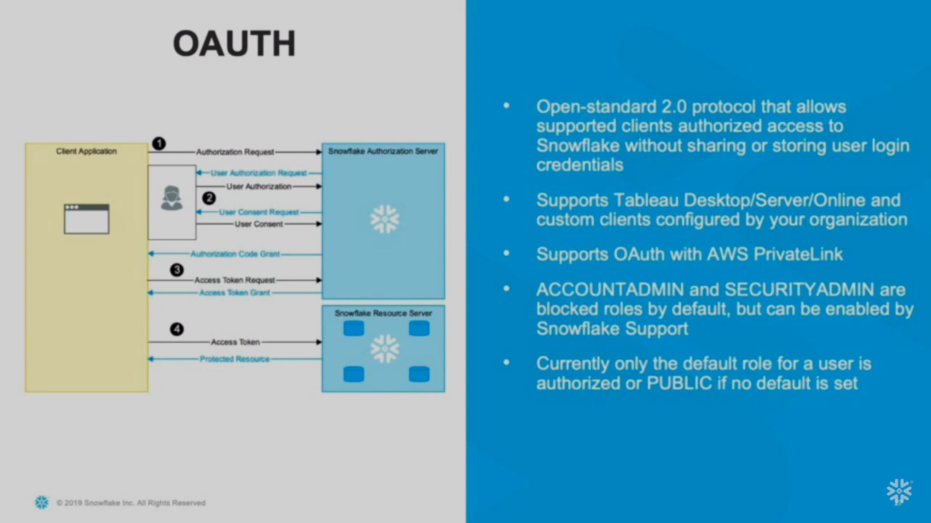

Slide 25
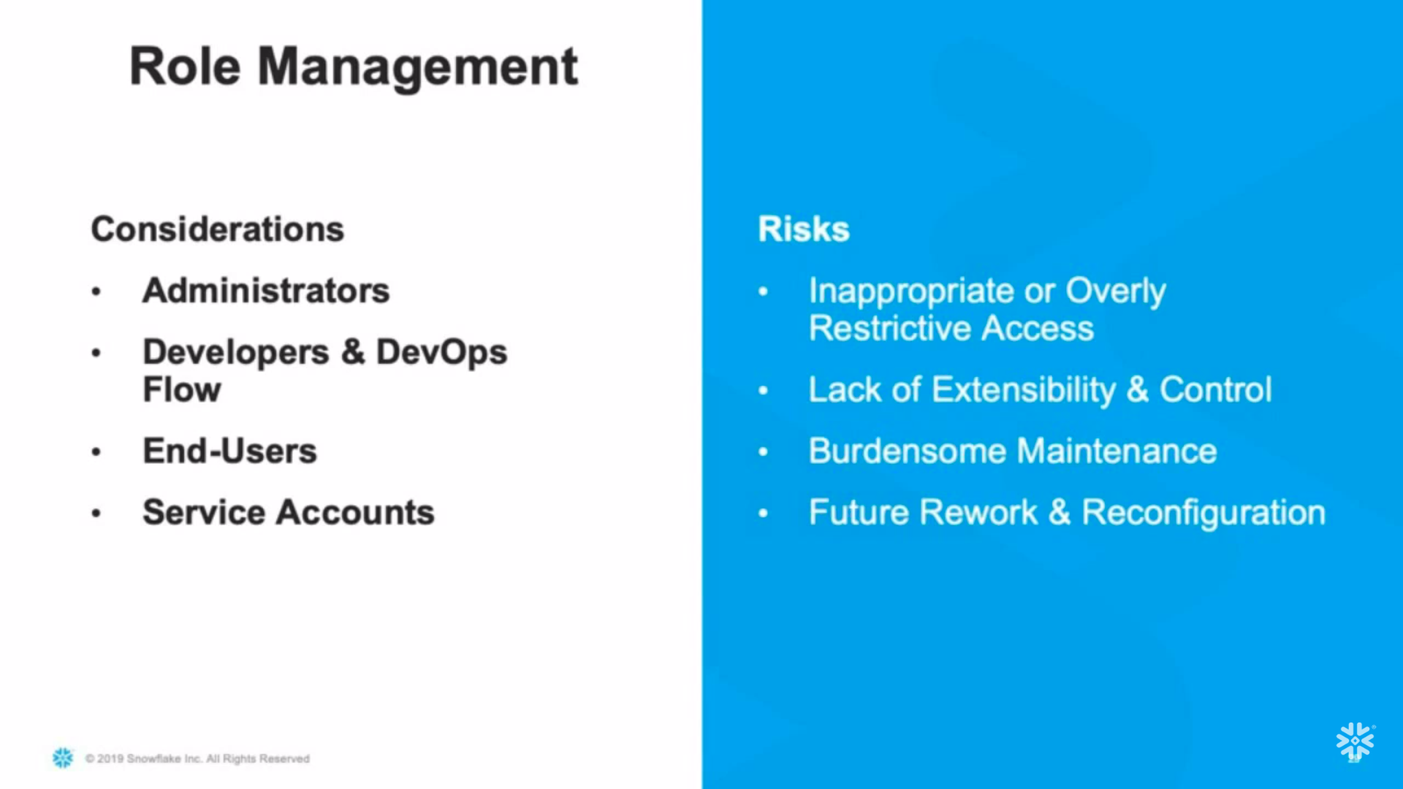

Slide 26
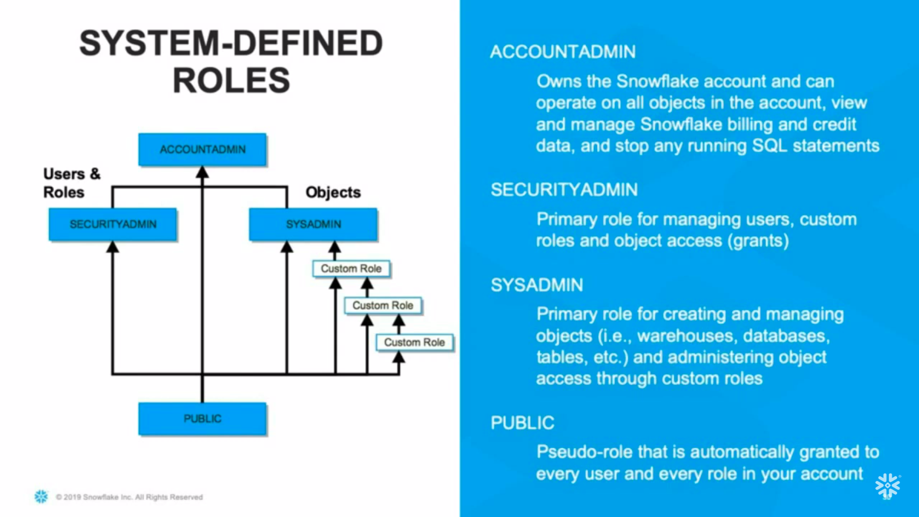

Slide 27
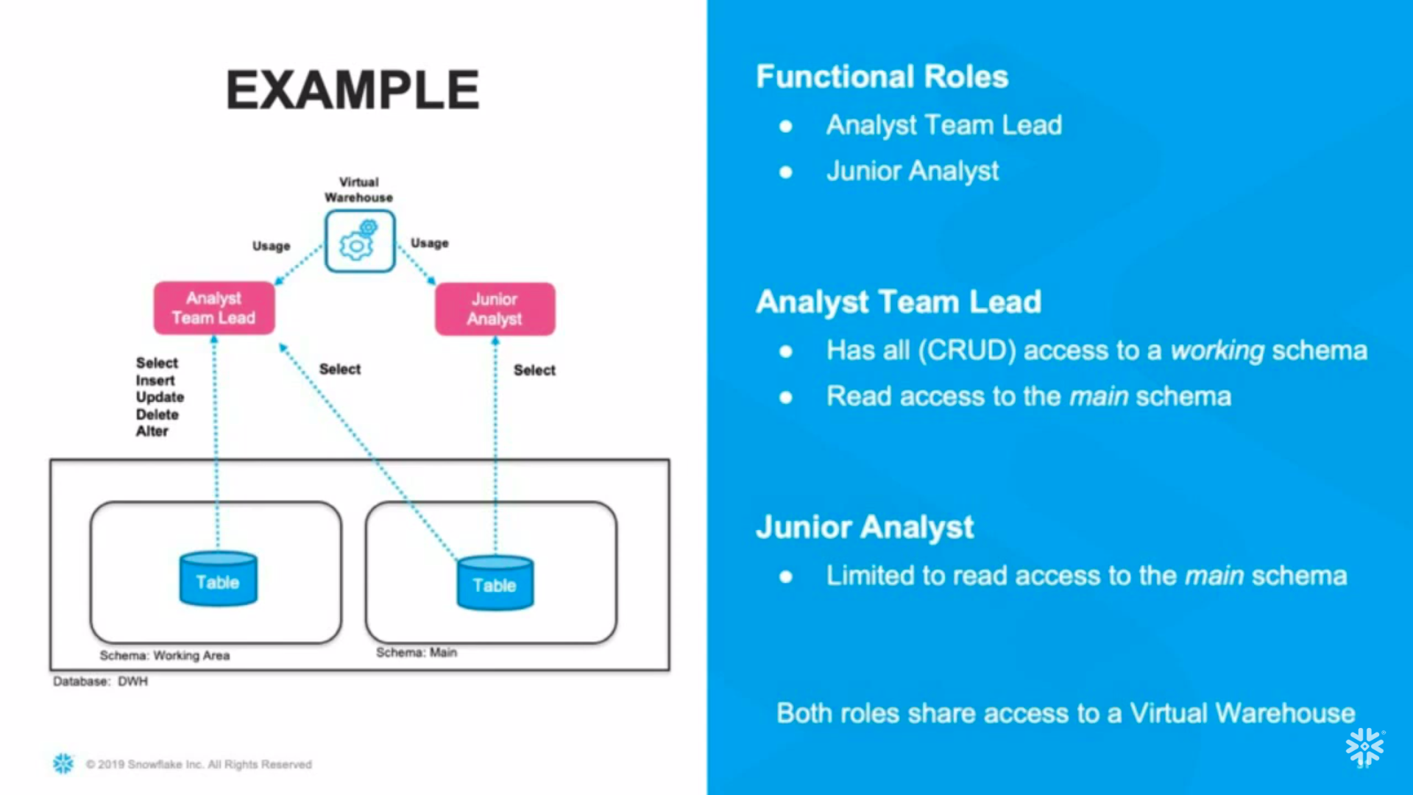

Slide 28
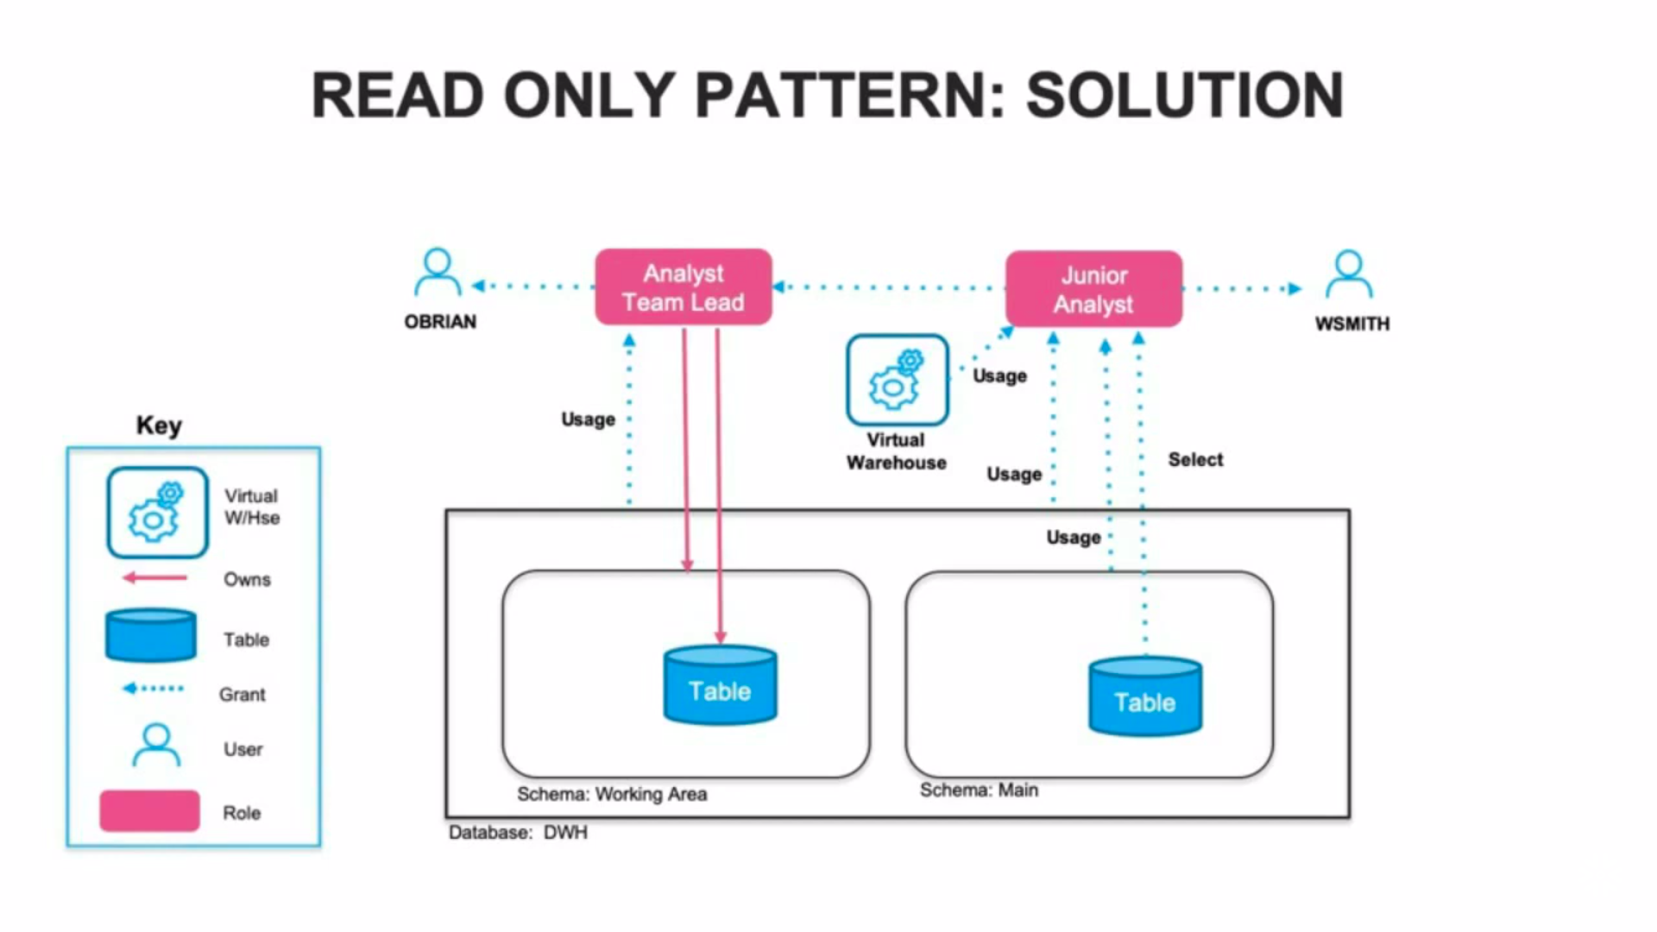

Slide 29
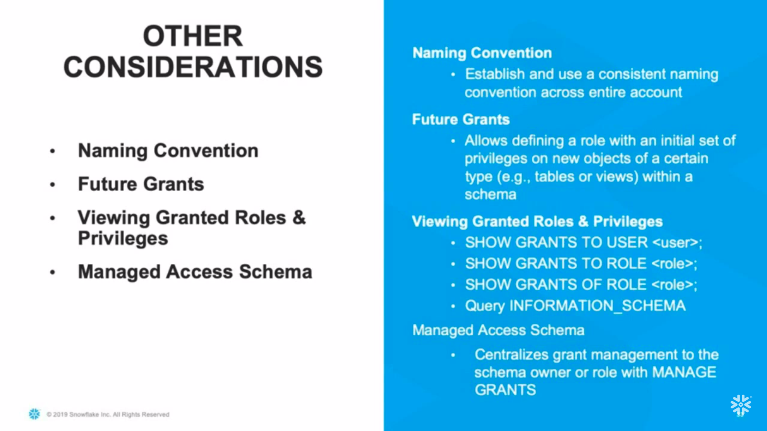

Slide 30
Data Engineering

Slide 31
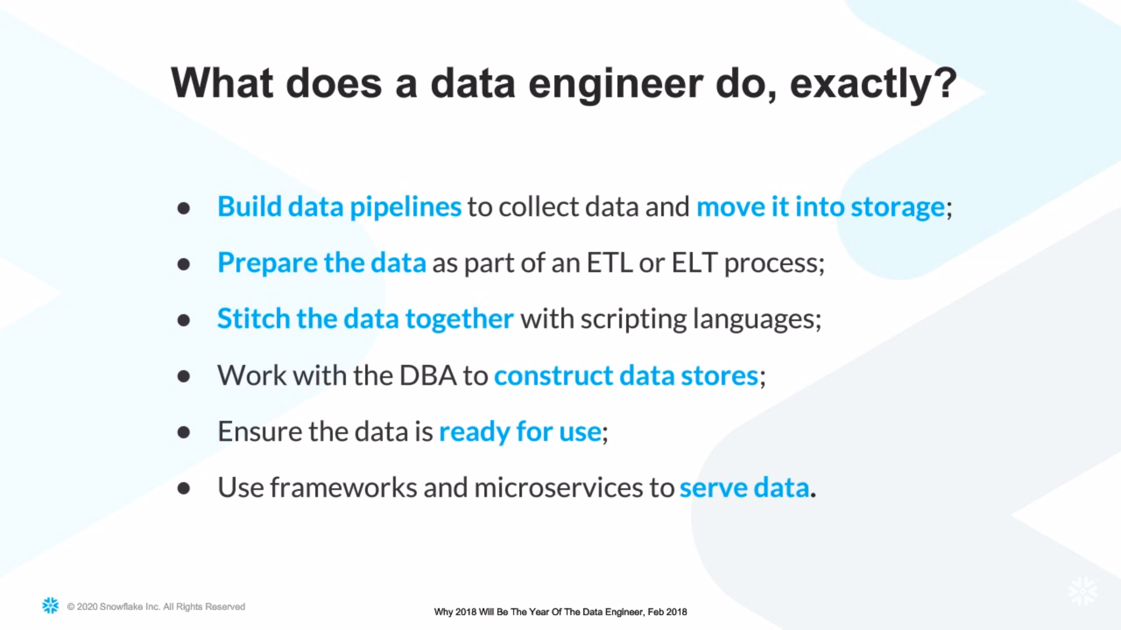

Slide 32
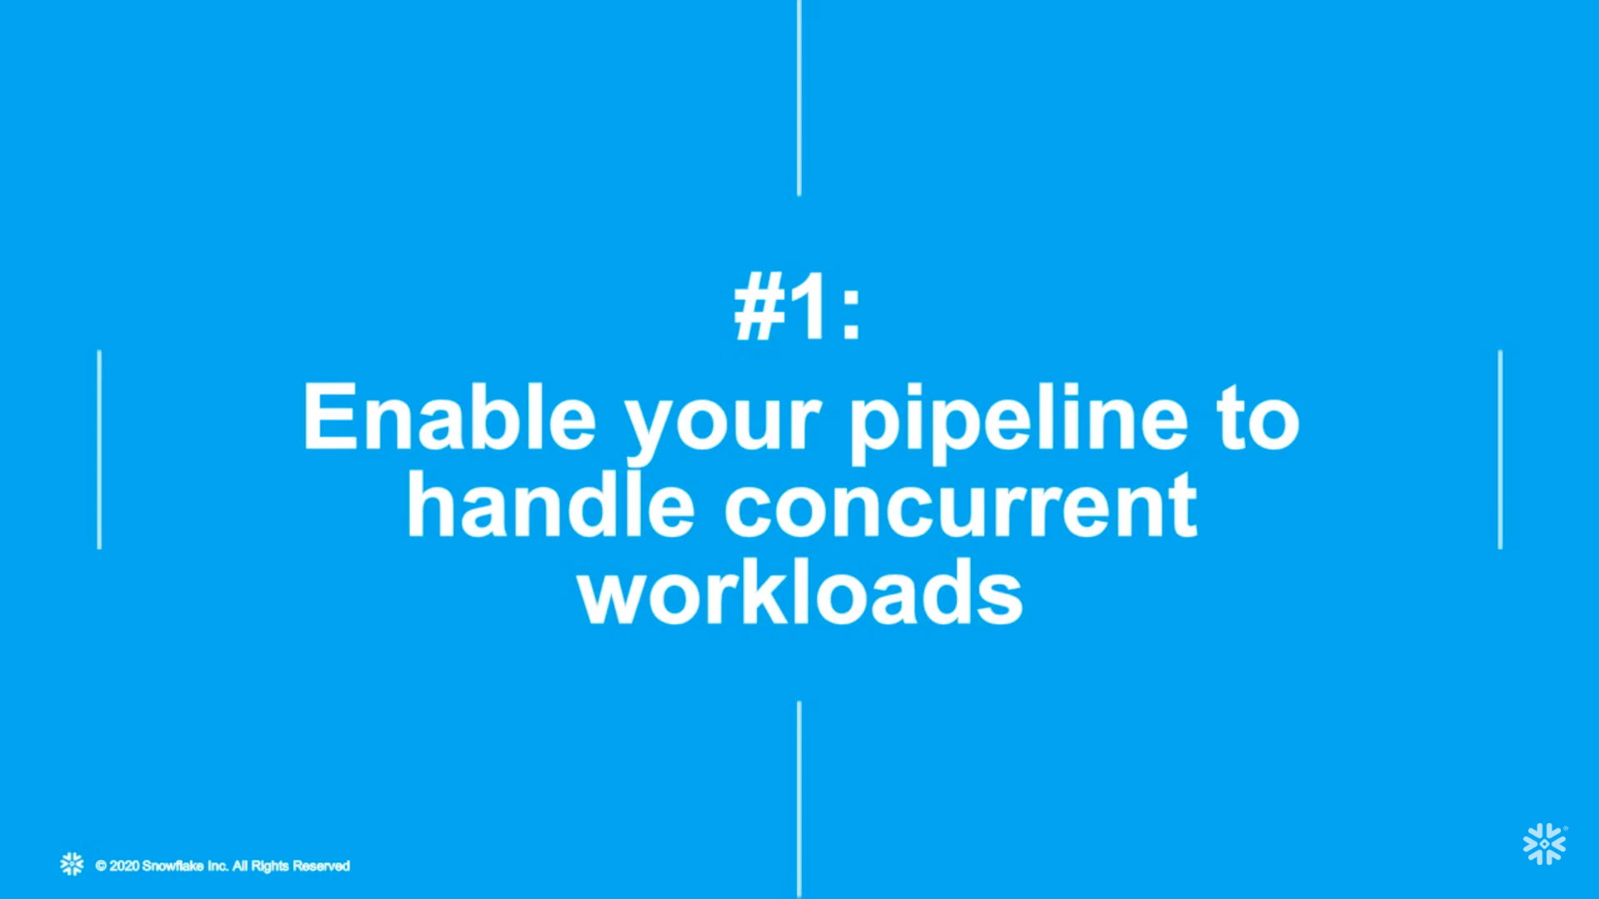

Slide 33
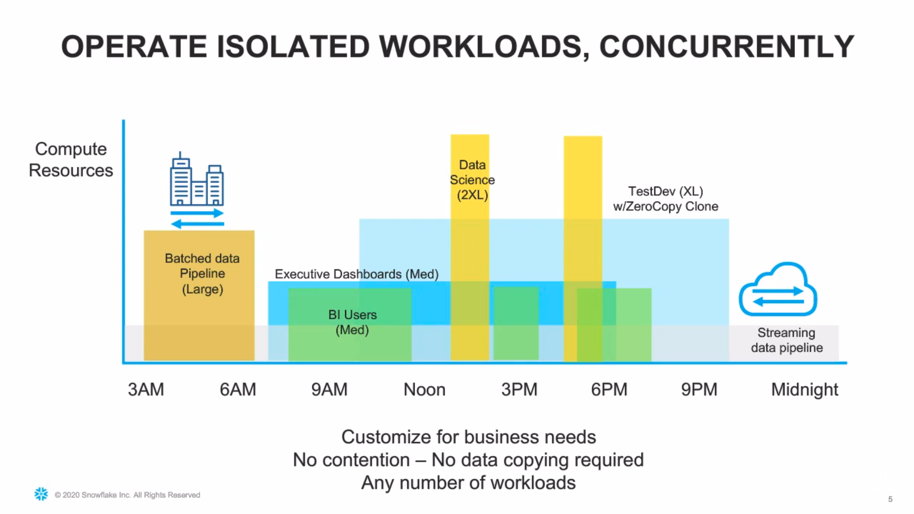

Slide 34
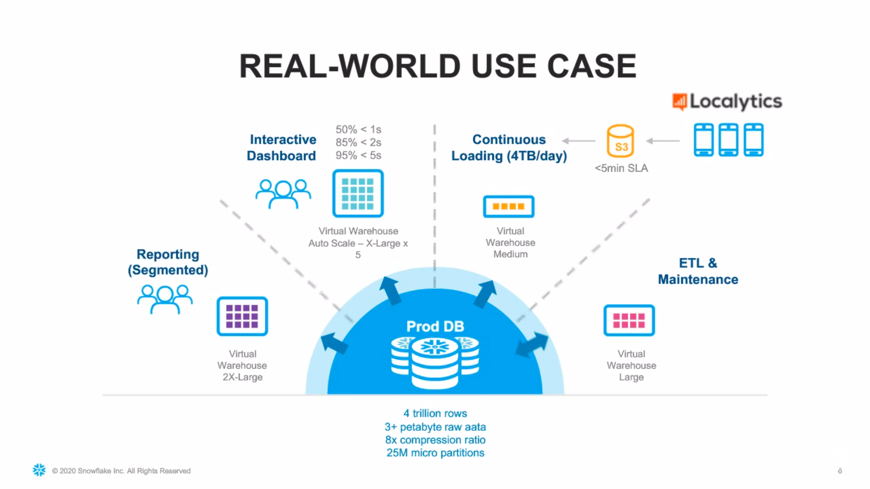

Slide 35


Slide 36


Slide 37
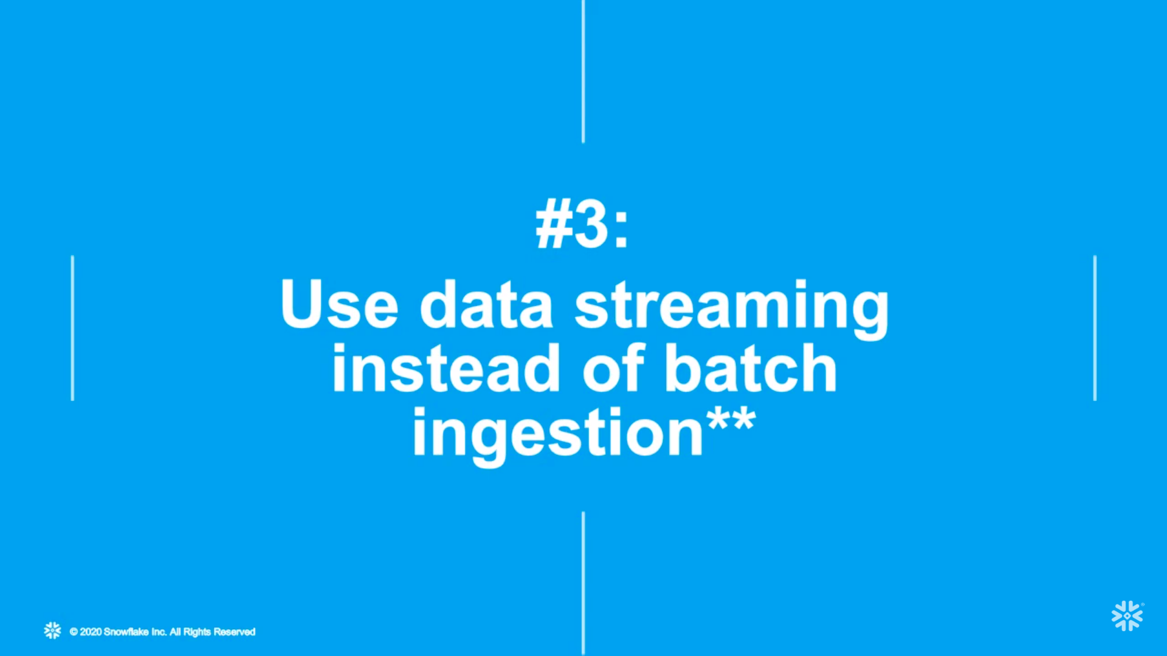

Slide 38
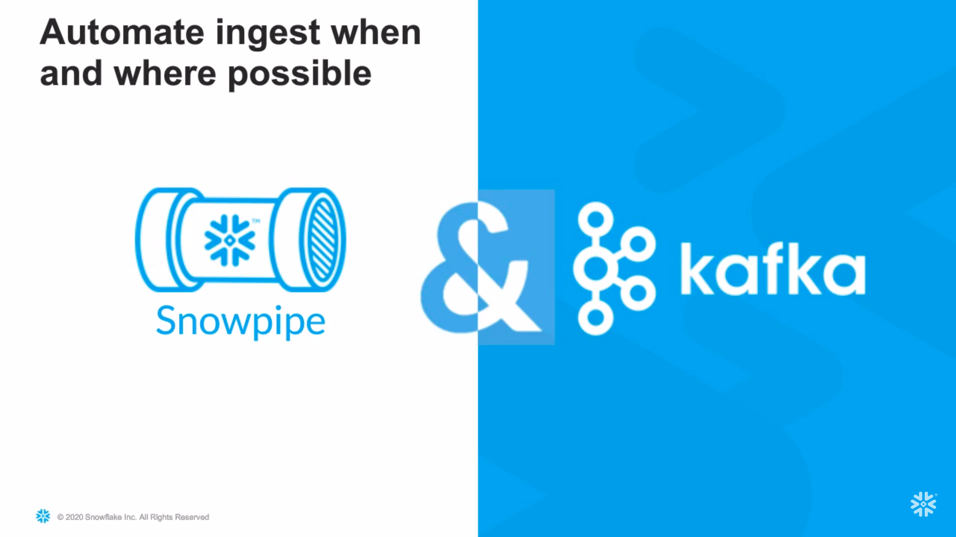

Slide 39


Slide 40
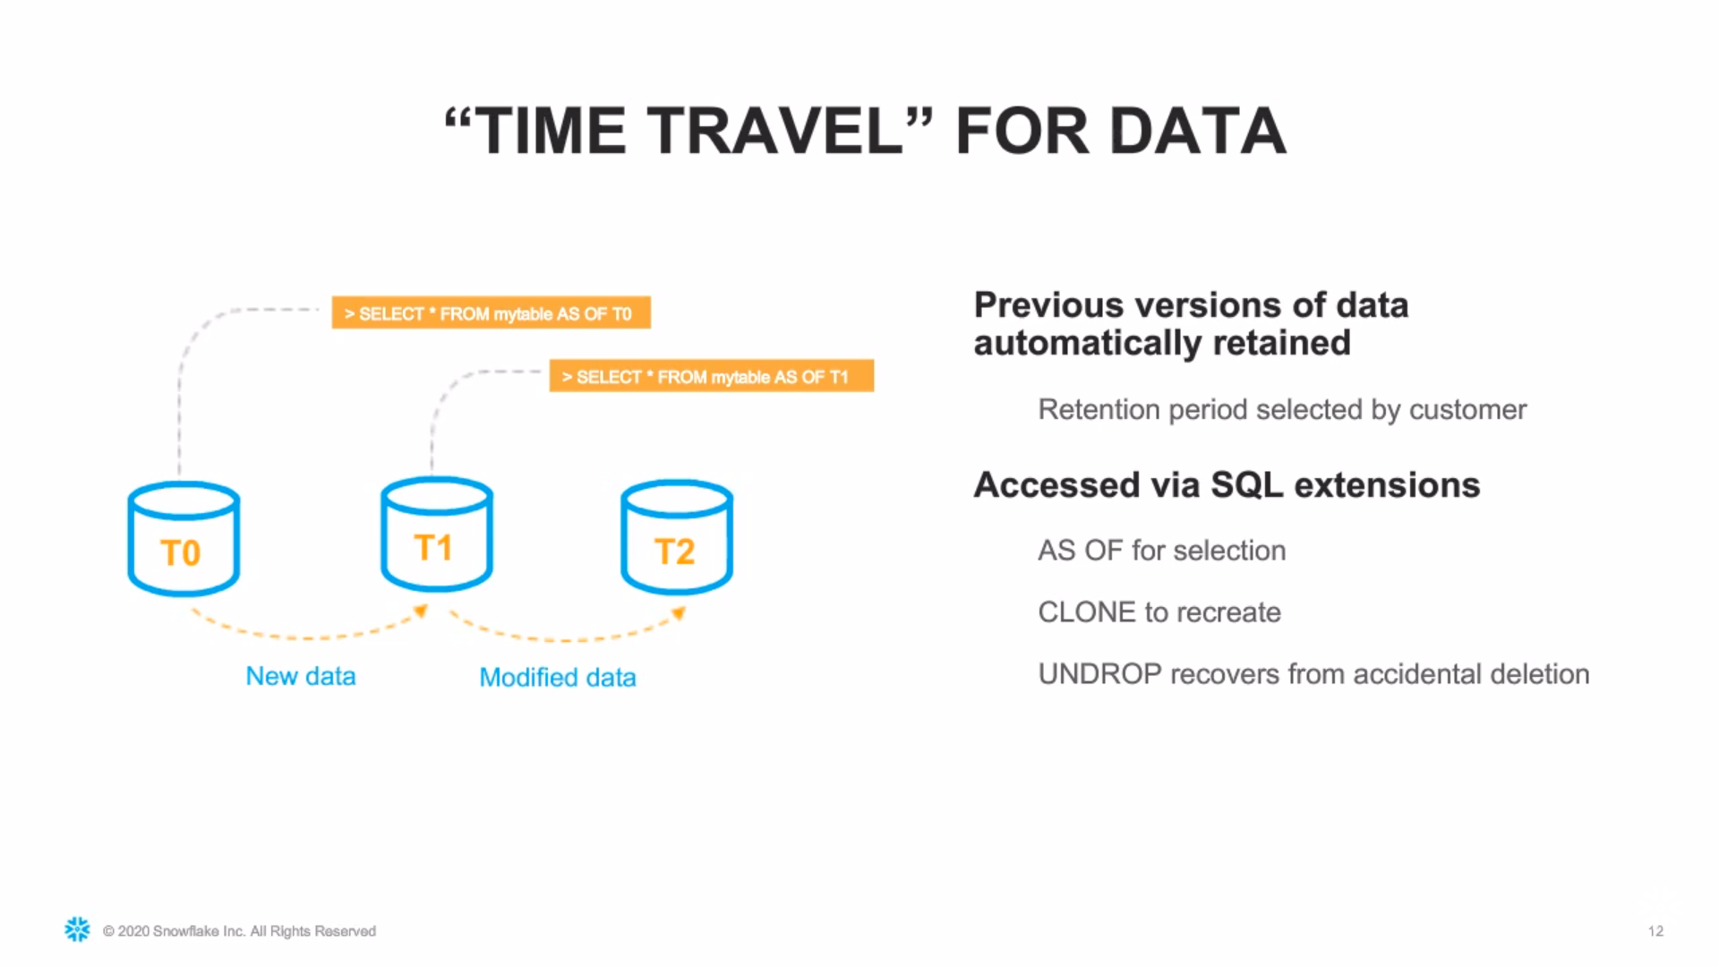

Slide 41
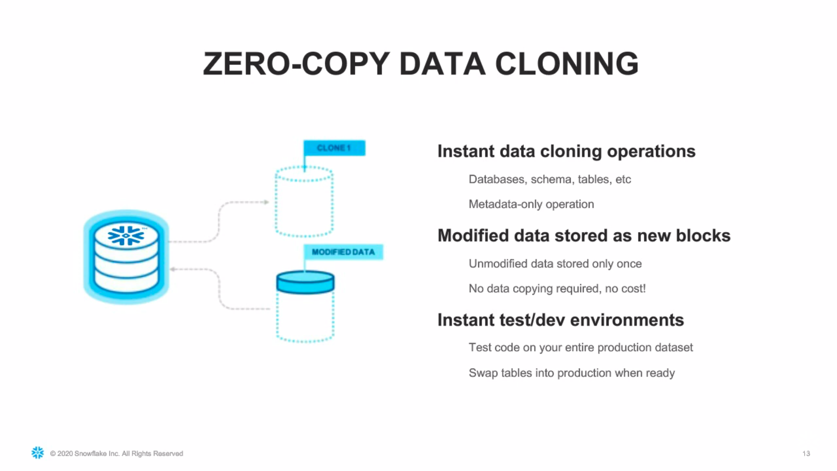

Slide 42
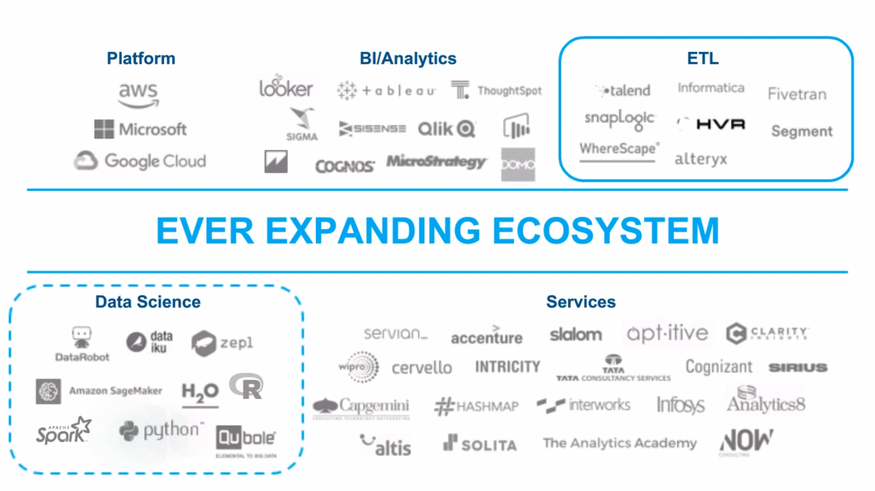

Slide 43


Slide 44
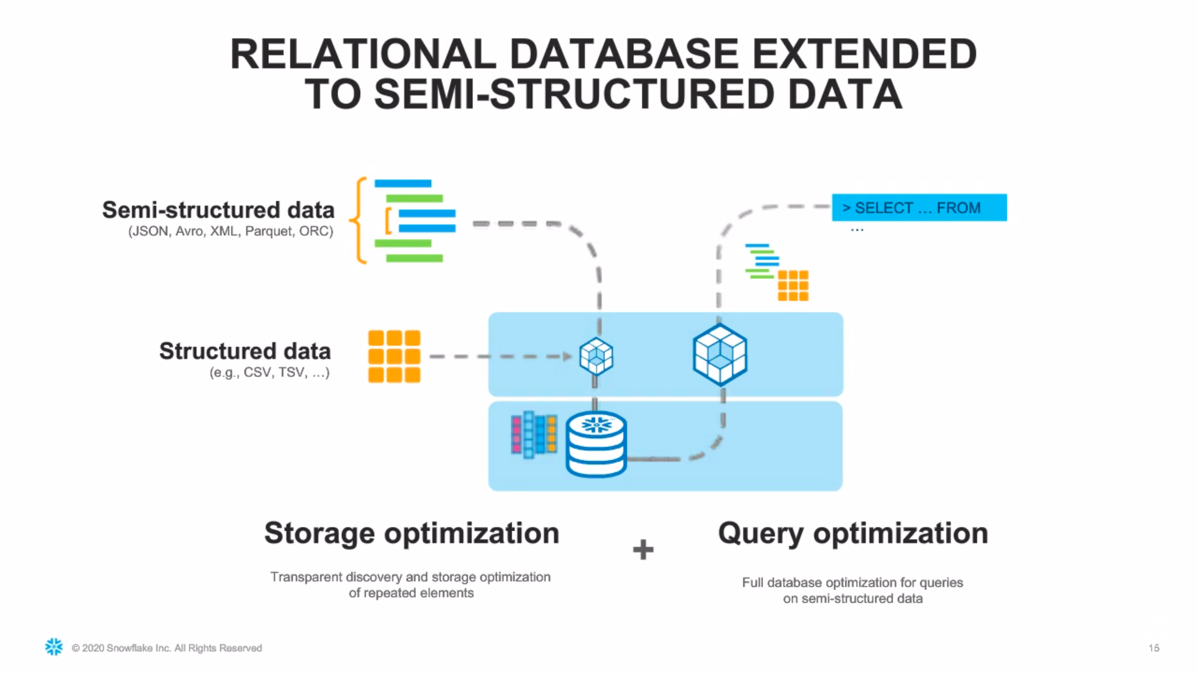

Slide 45


Slide 46


Slide 47
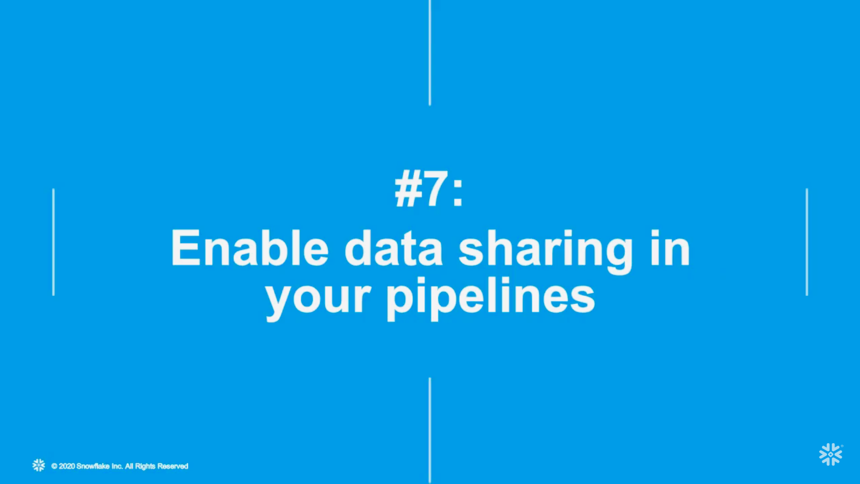

Slide 48
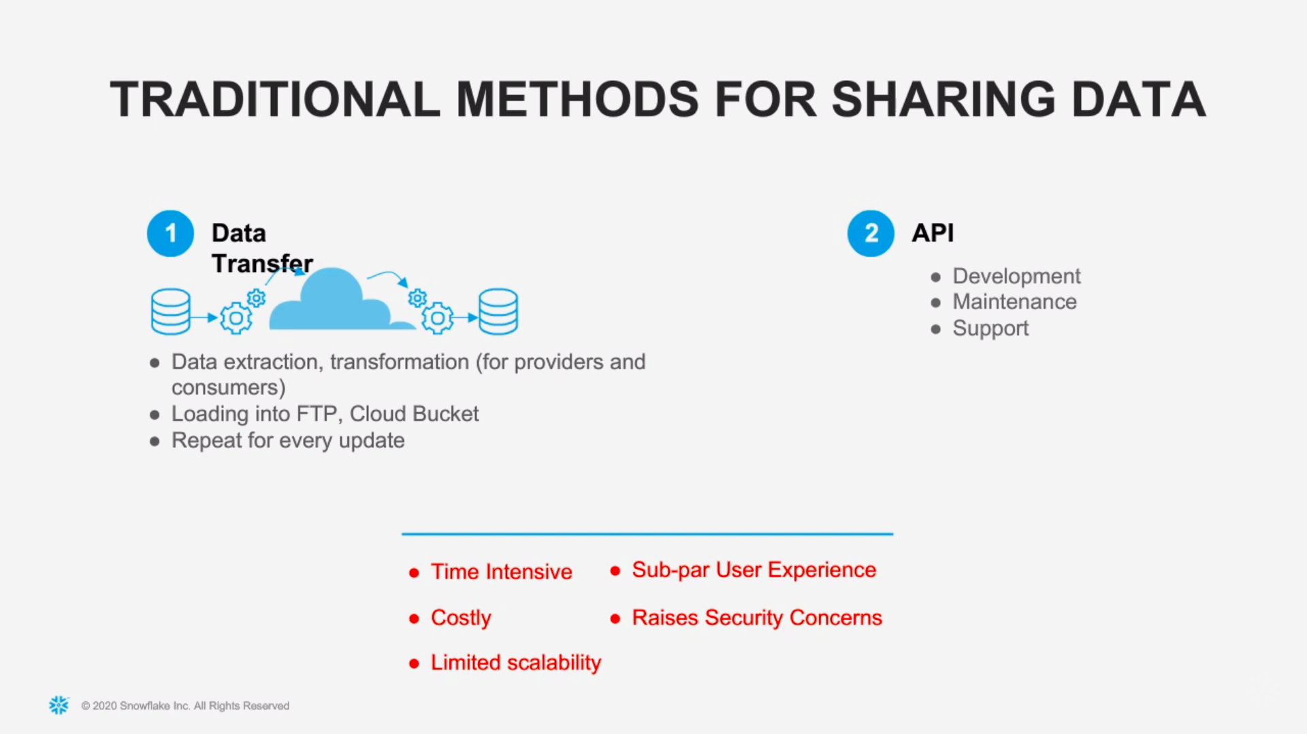

Slide 49
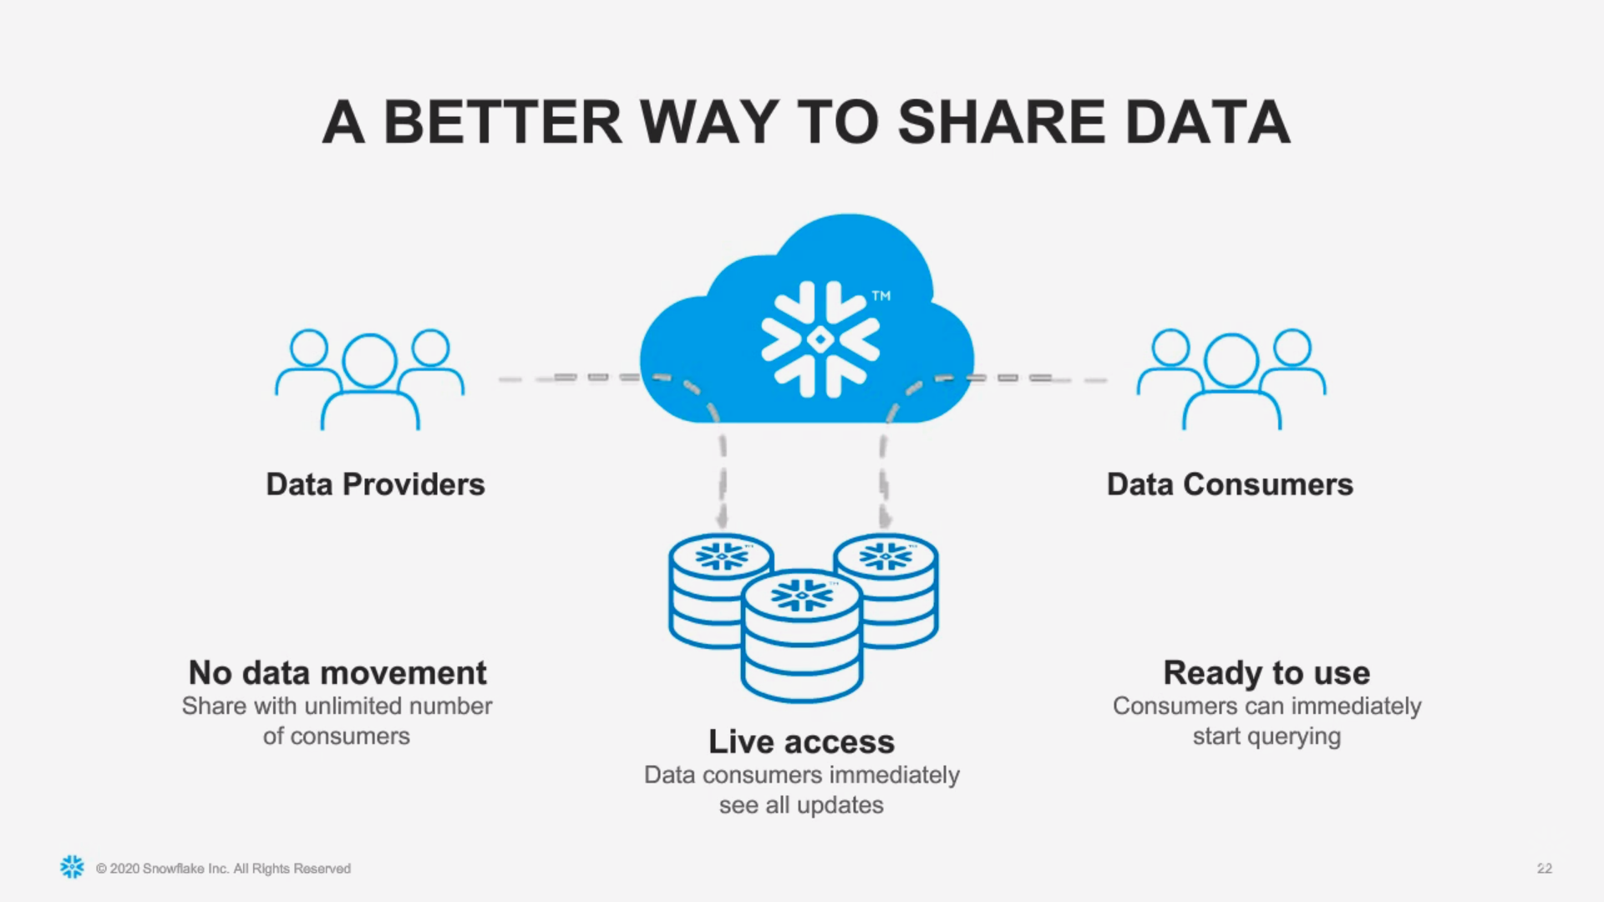

Slide 50
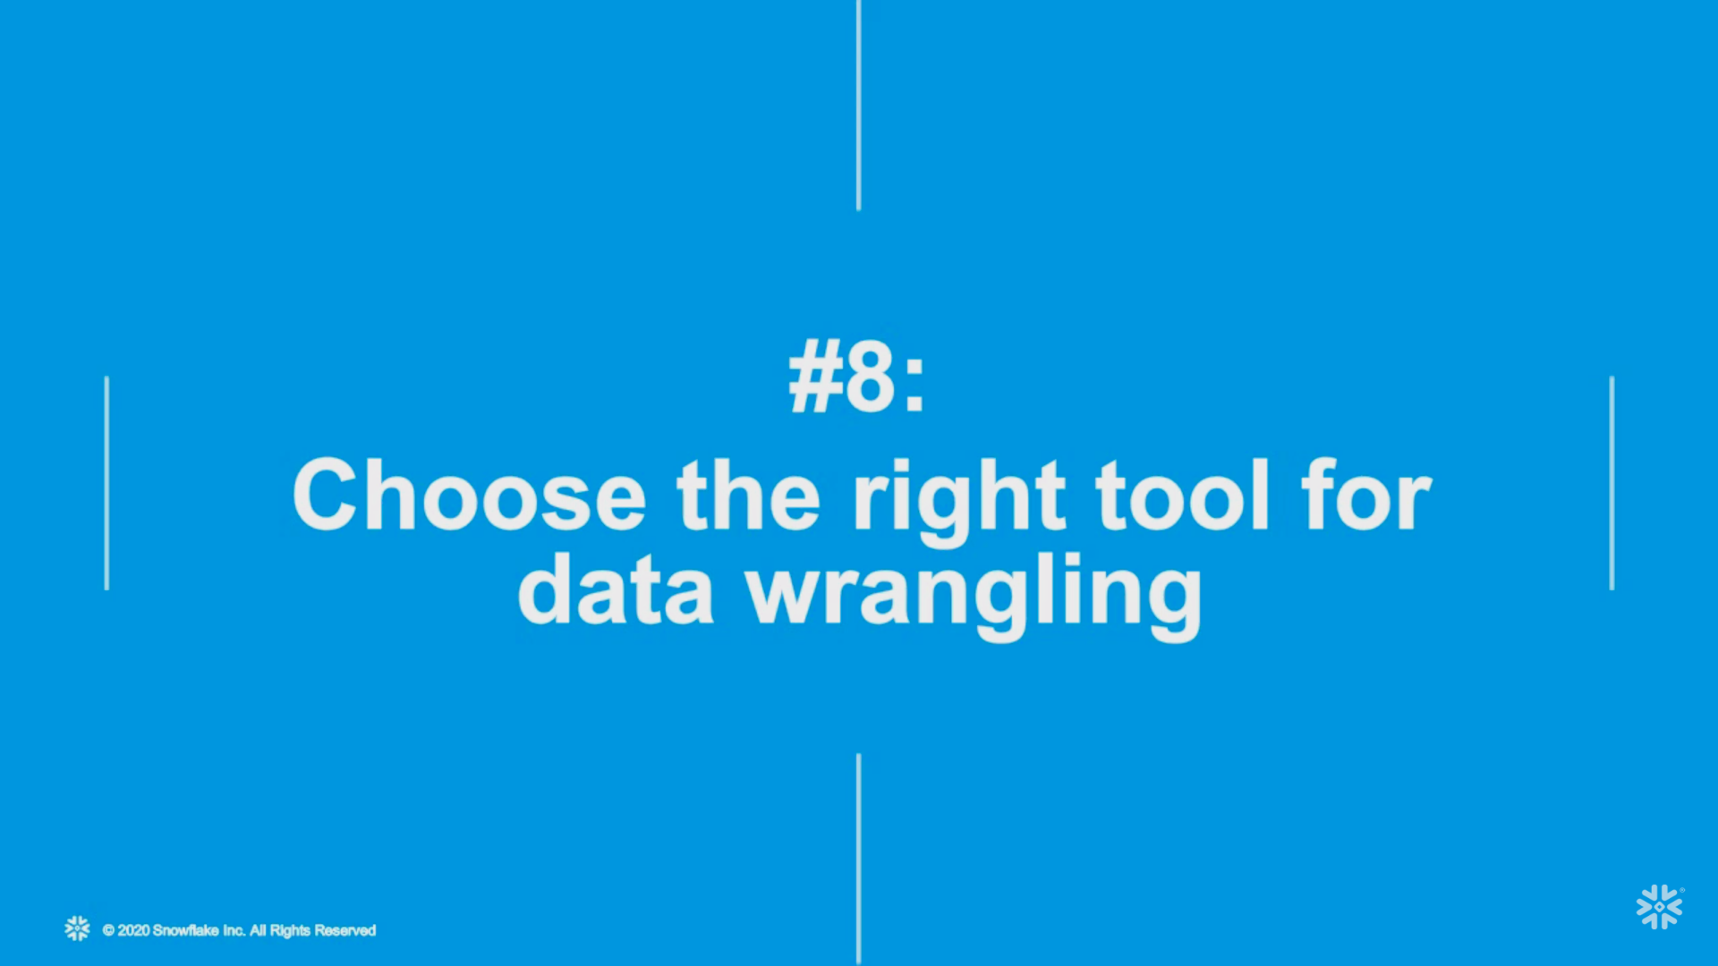

Slide 51
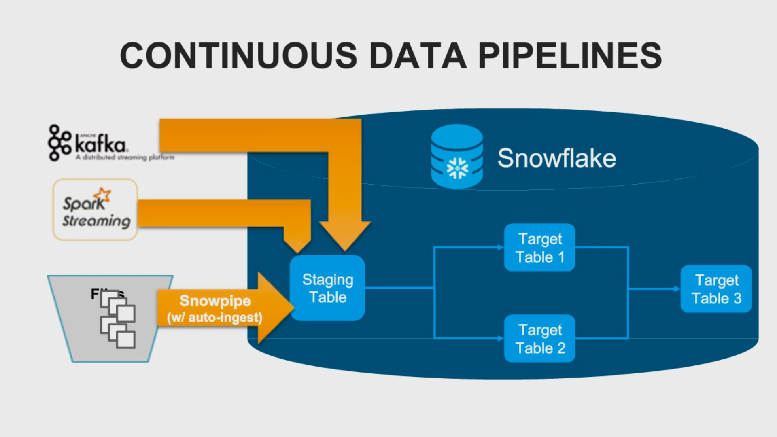

Slide 52
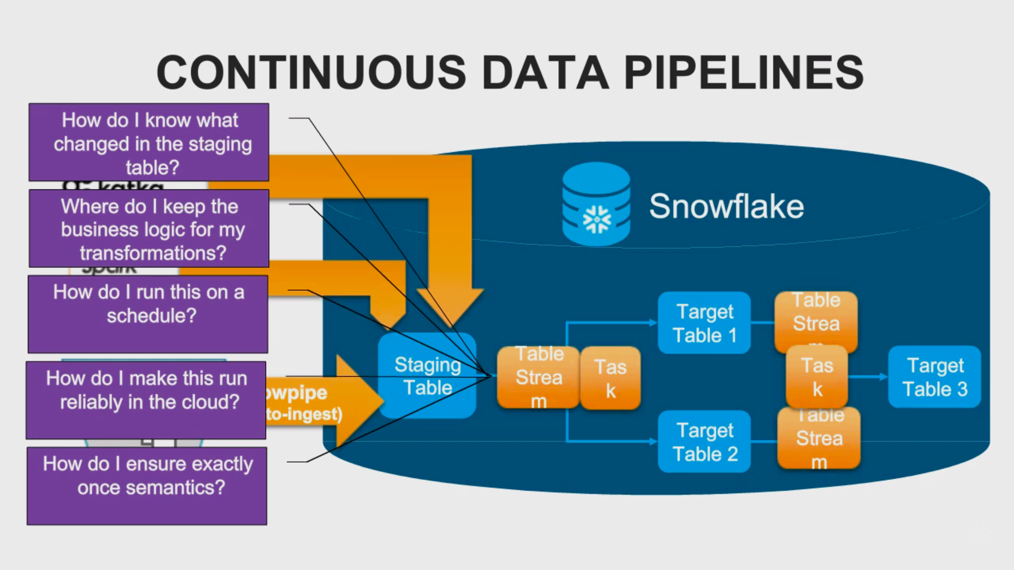

Slide 53


Slide 54


Slide 55
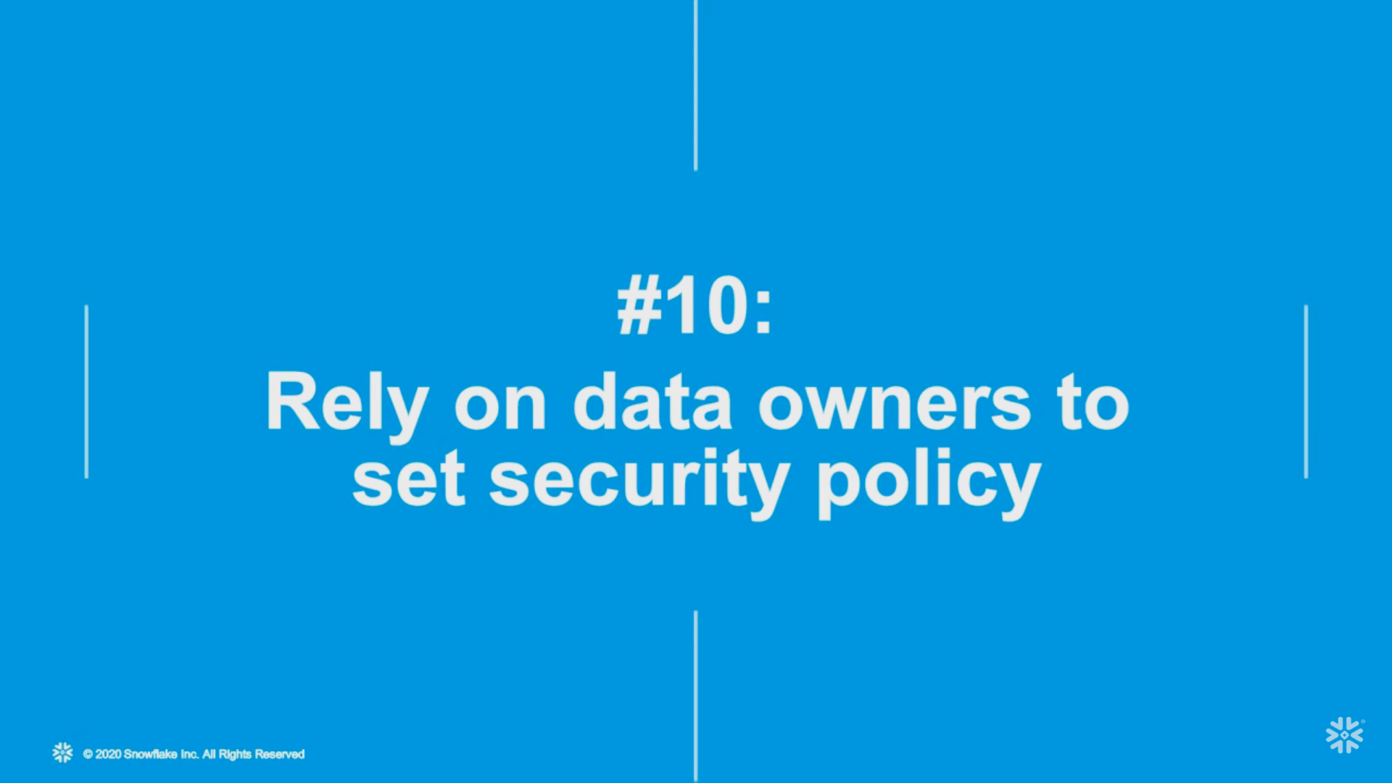

Slide 56
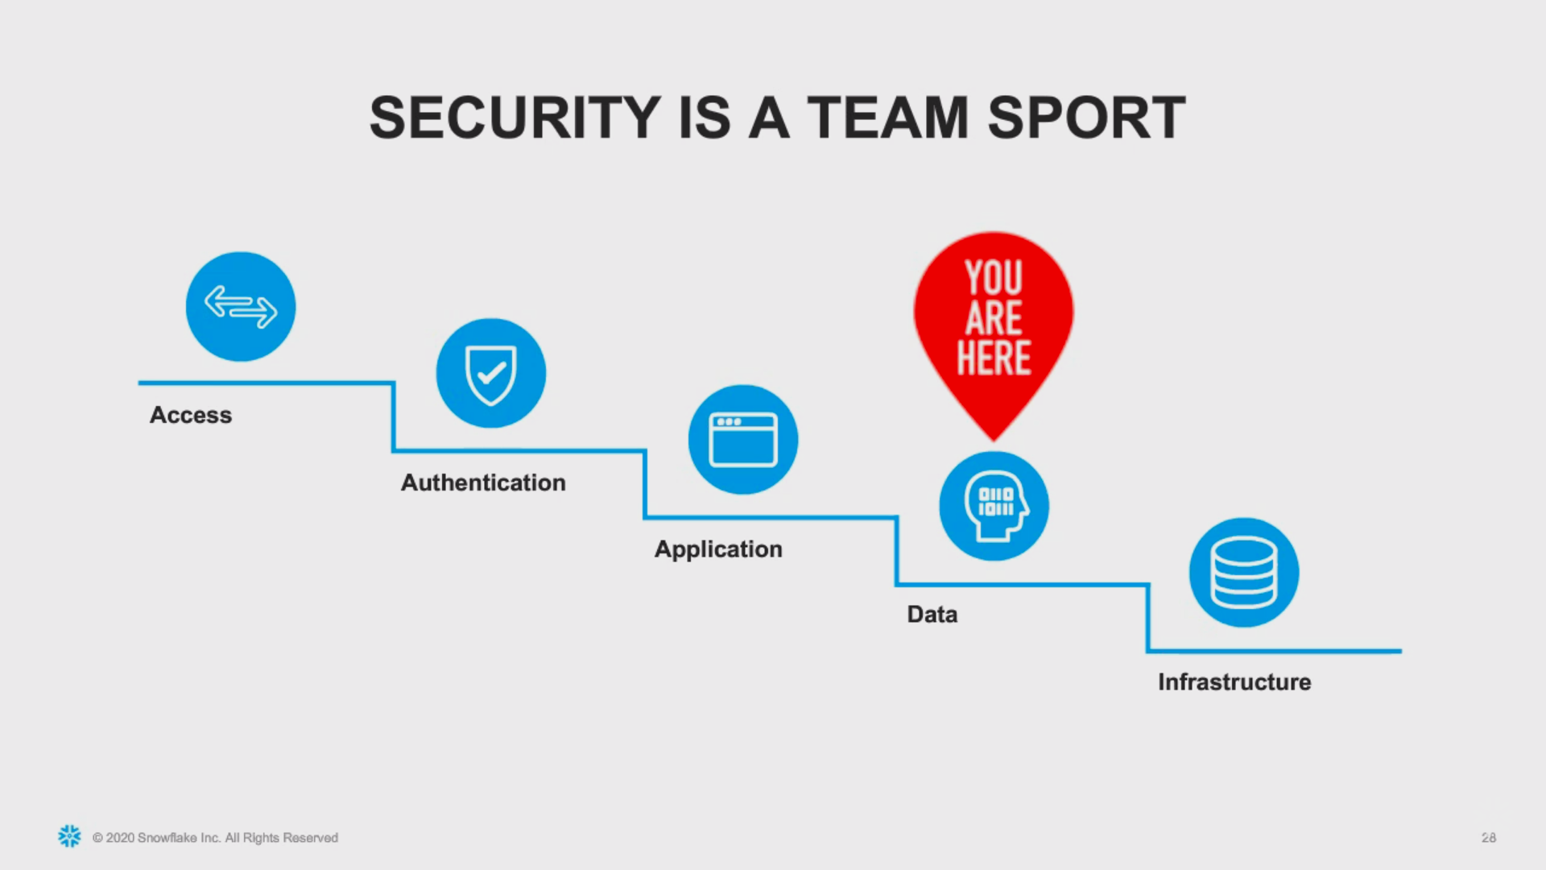

Slide 57
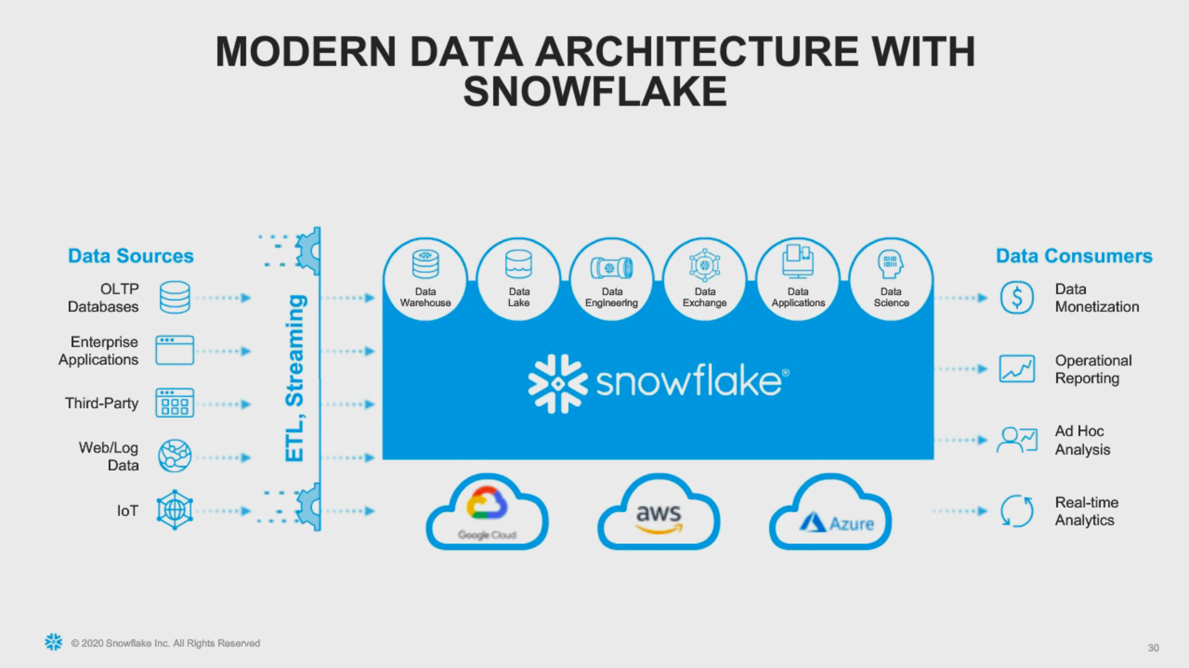

Slide 58
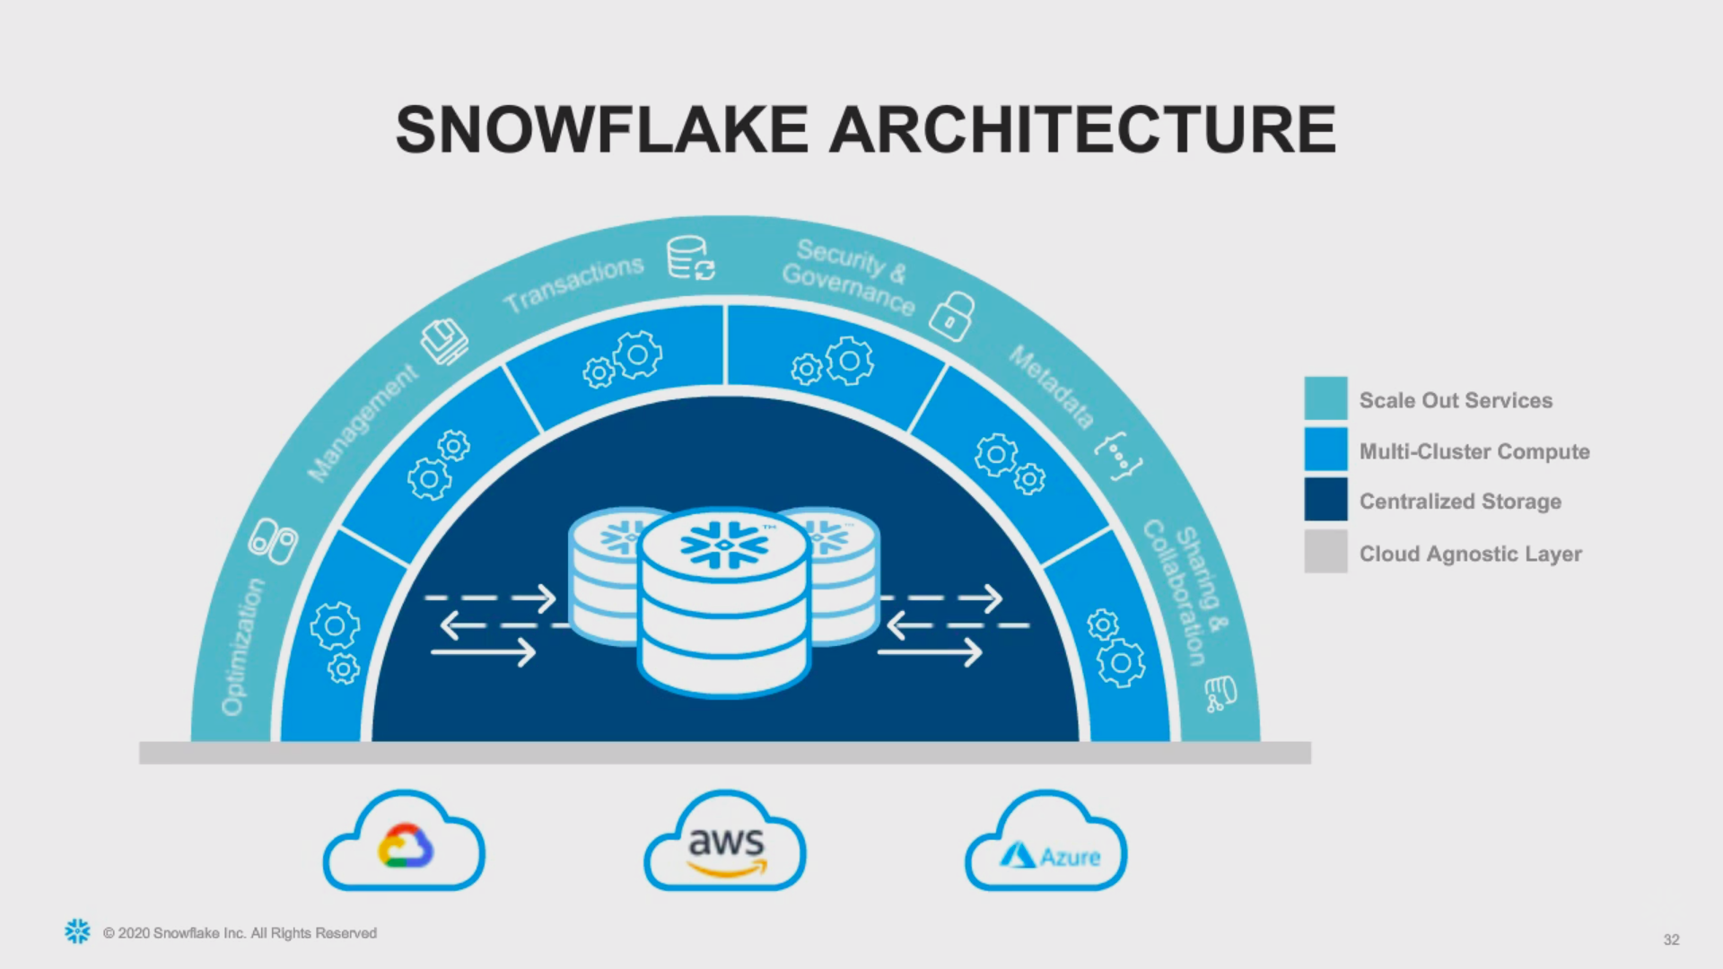

Slide 59
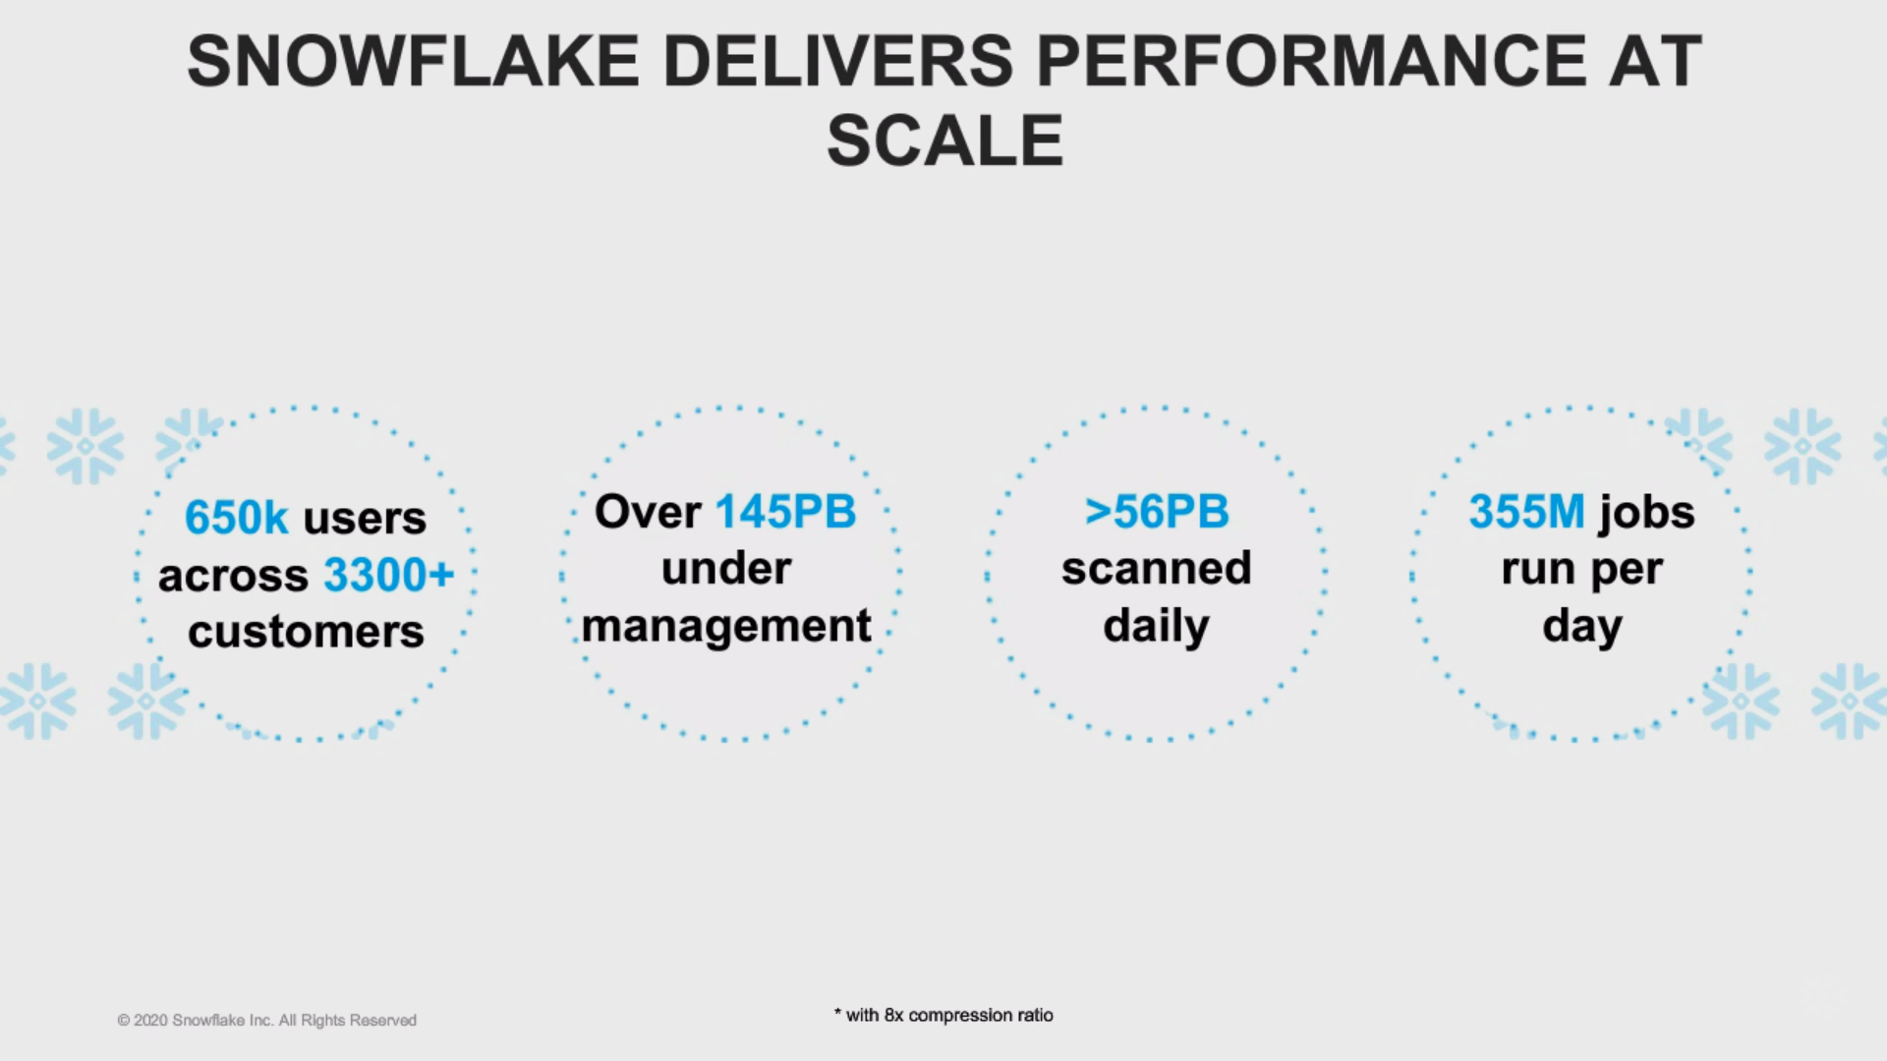

Slide 60


